Slide 1


Swasthya
The Virtual Dietician
SOFTWARE ENGINEERING PROJECT REPORT
[Submitted in partial fulfillment]
As a part of the curriculum of
B.Sc (H) COMPUTER SCIENCE
Submitted to: Submitted by:
MS ASHEMA HASTI DIYA GARG (18044570007)
Assistant Professor CHAKSHITA GUPTA (18044570015)
Deptt. of Computer Science MISHIKA RAWAT (18044570032)
Notes:
This template can be used as a starter file for presenting training materials in a group setting.
Sections
Right-click on a slide to add sections. Sections can help to organize your slides or facilitate collaboration between multiple authors.
Notes
Use the Notes section for delivery notes or to provide additional details for the audience. View these notes in Presentation View during your presentation.
Keep in mind the font size (important for accessibility, visibility, videotaping, and online production)
Coordinated colors
Pay particular attention to the graphs, charts, and text boxes.
Consider that attendees will print in black and white or grayscale. Run a test print to make sure your colors work when printed in pure black and white and grayscale.
Graphics, tables, and graphs
Keep it simple: If possible, use consistent, non-distracting styles and colors.
Label all graphs and tables.

Slide 2
PROBLEM STATEMENT
Our proposed project title is Swasthya-Virtual Dietician Bot.
‘Swasthya’ proposes an intelligent agent for setting up diet plans based on the inputs provided by the user. The system creates a meal plan in accordance with a person’s lifestyle and health requirements. The online artificial dietician is a system having artificial intelligence about human diets.
The prime objective of the software is to list all the possible diet plans along with the nutrient value of the food items for the user in accordance with his/her lifestyle by taking their height, weight, working hours, and eating hours and practices as inputs. It also provides light exercise plans for a healthy living.
What makes this bot better over existing artificial dieticians is the added functionality that the registered users can have direct conversations through messages with a certified dietician(s) to get the best of our services. Moreover, it will keep a track of past inputs and data of the user and put forth the diet plan after considering the user's history.
Notes:
Give a brief overview of the presentation. Describe the major focus of the presentation and why it is important.
Introduce each of the major topics.
To provide a road map for the audience, you can repeat this Overview slide throughout the presentation, highlighting the particular topic you will discuss next.

Slide 3

PROCESS MODEL
We have followed Incremental Process Model because:
It combines elements of linear and parallel process flows, and generates working software quickly and early during the software lifecycle.
This is more flexible and less costly to change scope and requirements. It is easier to test and debug during a smaller iteration.
In this model, the customers can respond to each built. Also, functionality can be refined and expanded in the later stages in the later software releases. The user can visualize the software before the completion of the entire project in order to evaluate and provide feedback.
We are using this model as requirements are completely understood, however, small changes can be incorporated.
Notes:
This is another option for an Overview slides using transitions.

Slide 4
REQUIREMENTS
ANALYSIS
Notes:
Use a section header for each of the topics, so there is a clear transition to the audience.

Slide 5

DATA FLOW DIAGRAMS

Slide 6

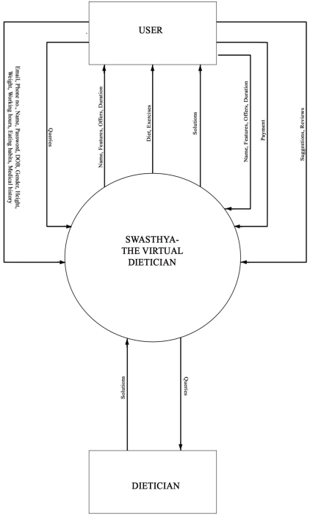
Context Diagram

Slide 7
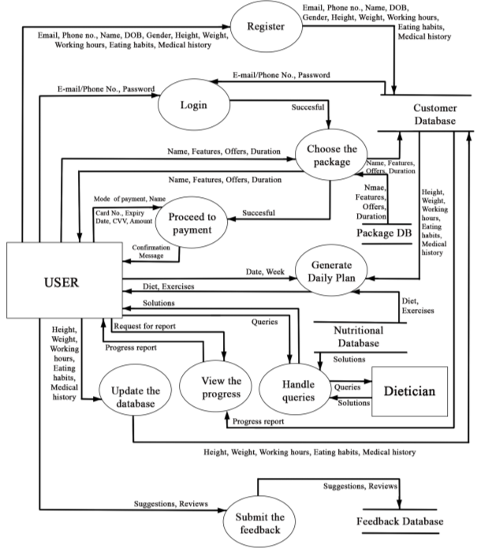
Level 1
DFD

Slide 8
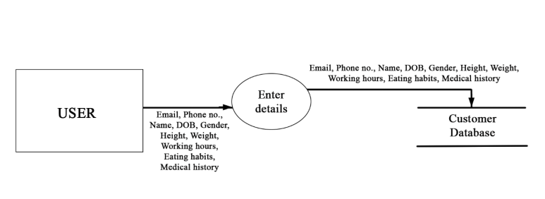
Level 2
DFD
REGISTRATION

Slide 9
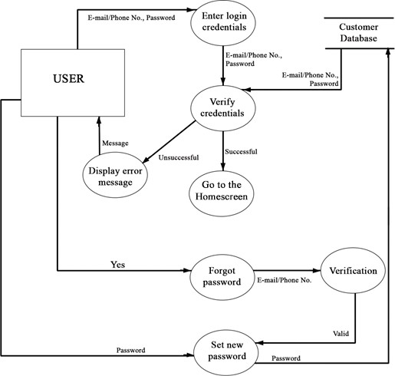
Level 2
DFD
LOGIN

Slide 10
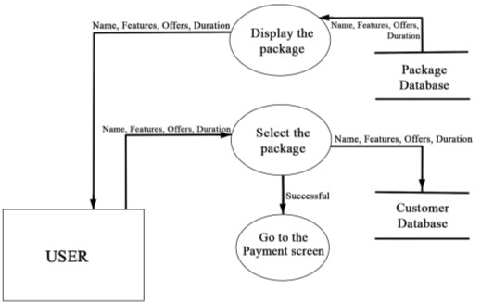
Level 2
DFD
CHOOSE THE PACKAGE

Slide 11
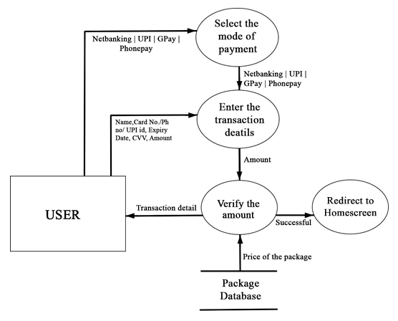
Level 2
DFD
PAYMENT

Slide 12
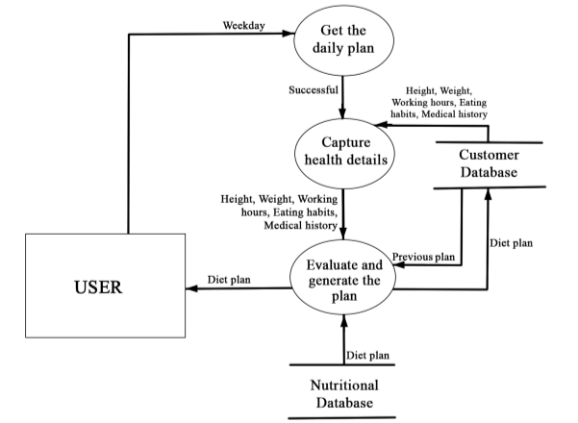
Level 2
DFD
GENERATION OF PLAN

Slide 13
Level 2
DFD
UPDATE THE DETAILS

Slide 14
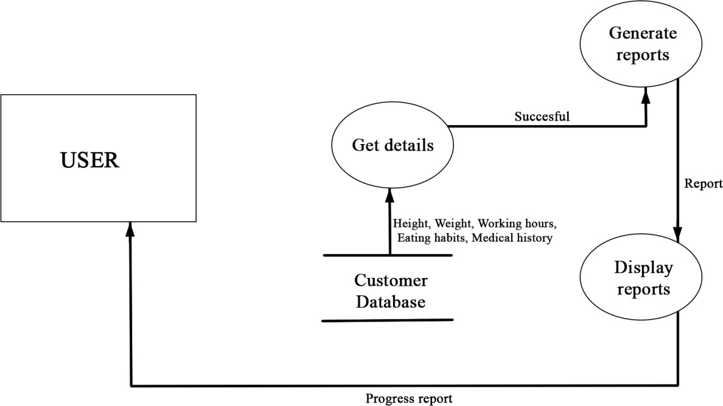
Level 2
DFD
PROGRESS REPORT

Slide 15
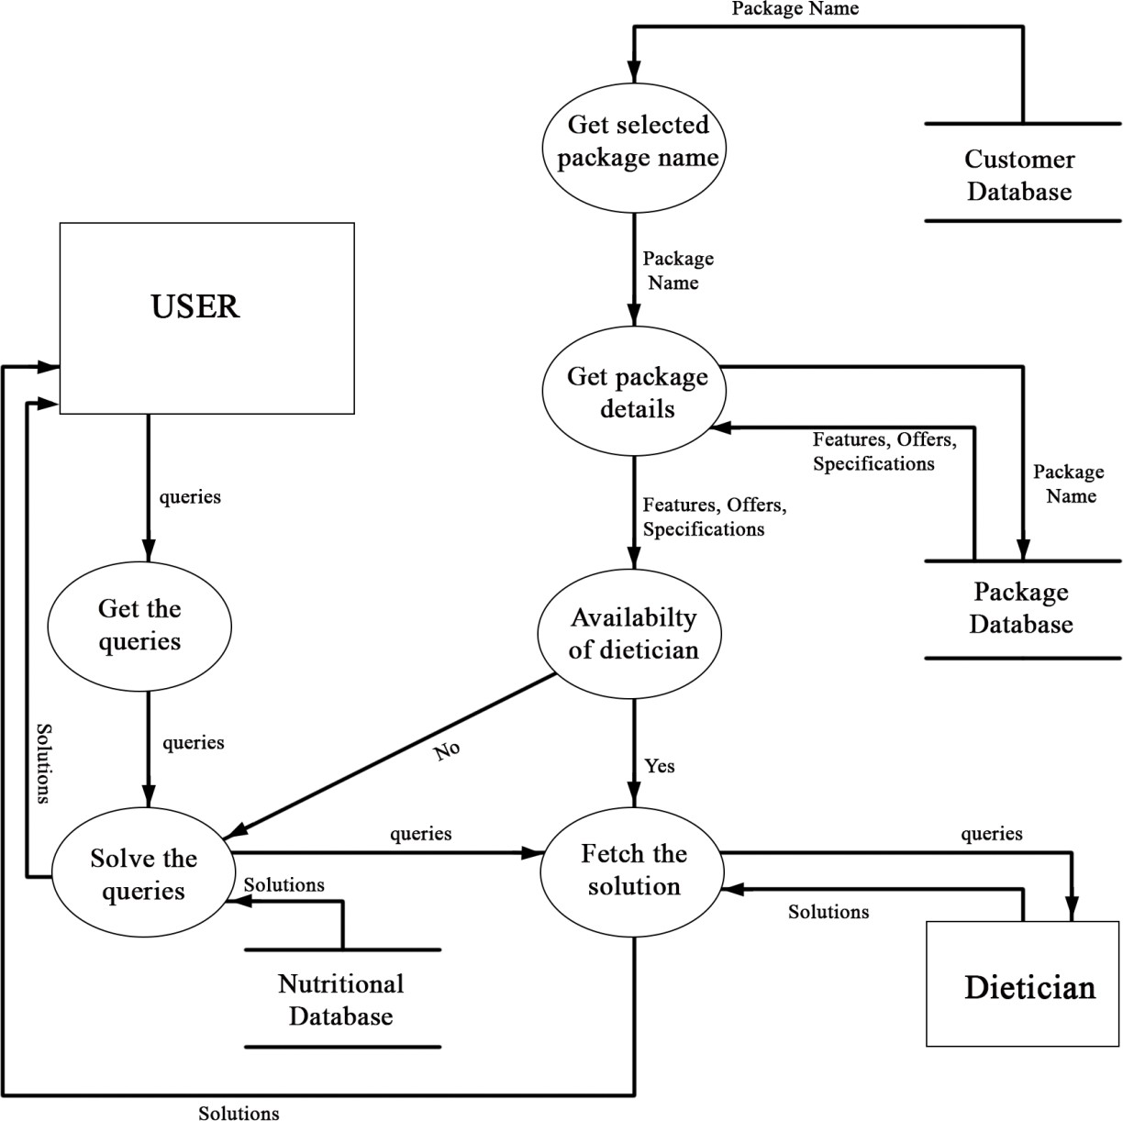
Level 2
DFD
QUERIES

Slide 16
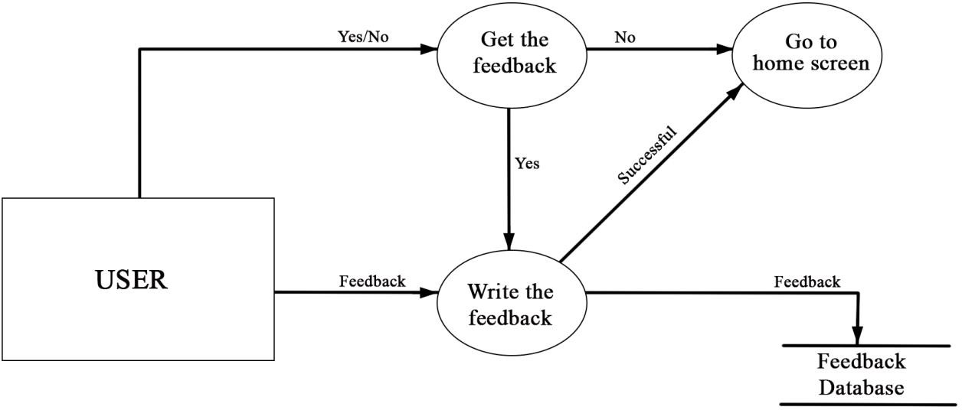
Level 2
DFD
FEEDBACK

Slide 17
DATA DICTIONARY
Legal character: [a-z|A-Z]
Digit: [0-9]
Special character: [@|$|#|+|-|.]
1 | Name | {Legal character}*
2 | Email id | {Legal characters+Digit+special characters}*
3 | Username | {Legal characters+Digit+special characters}*
4 | Password | {Legal characters+Digit+special characters}*
5 | Contact | {Digit+ Digit+ Digit+ Digit+ Digit+ Digit+ Digit+ Digit+ Digit+ Digit}
6 | Date Of Birth | {Digit+ Digit+ Digit}*
7 | Gender | {Legal character}*
8 | Height & Weight | {Digit+ Digit}*
9 | Working Hours | {Digit+ Digit}*
10 | Medical History | {Legal character}*
11 | Eating Habits | {Legal character}*
12 | Queries | {Legal character}*
13 | Payment | {Digit+ Digit+ Digit+ Digit}
14 | Offers | {Legal characters+Digit+special characters}*
15 | Feedback | {Legal character}*
Notes:
This is another option for an Overview slide.

Slide 18
FUNCTIONAL REQUIREMENTS
Notes:
Use a section header for each of the topics, so there is a clear transition to the audience.

Slide 19
FR1- Register
Input data: Name, address, phone number, email id, date of birth, gender, height, working hours, eating habits, medical history, username and password.
Processing step: The user who is new to the app must register.
Output Data: The user has registered in the app and have valid credentials.
FR2 – Login
Input data: E-mail id or phone number and password.
Processing step: User can now login in the app.
Output Data: The user can use the application and get to home screen.
FR3 –Choose package
Input data: Name, features, offers and duration of the package.
Processing step: The user will select the desired package.
Output Data: Proceed to payment gateway.
FR4 – Generate the daily plan
Input data: Day of the week.
Processing step: Suitable diet and exercise plan will be made for user according to needs.
Output Data: Diet and exercise plan will be provided to the user.
Notes:
Add slides to each topic section as necessary, including slides with tables, graphs, and images.
See next section for sample table, graph, image, and video layouts.

Slide 20
FR5 – Manage Progress Report
Input data: Height, weight, working hours, eating habits, medical history.
Processing step: Gathering information from the database and generating report.
Output Data: Progress Report.
FR6 – Query
Input data: User query.
Processing step: The user can ask for changes in plan.
Output Data: Updated plan (may or may not be available).
FR7 – Payment
Input data: Credit card number, month, year, CVV, amount.
Processing step: The payment has to be made for the selected package.
Output data: Status of package and confirmation message.
FR8 – Update the details
Input data: Height, weight, working hours, eating habits, medical history
Processing step: The details will be updated in the database.
Output data: Updated details of the user
FR9 – Feedback
Input data: Reviews/suggestions
Processing step: Storing in the corresponding database.
Output data: Feedback submitted
Notes:
Add slides to each topic section as necessary, including slides with tables, graphs, and images.
See next section for sample table, graph, image, and video layouts.

Slide 21
PROJECT PLANNING
Notes:
Use a section header for each of the topics, so there is a clear transition to the audience.

Slide 22
PROJECT SCHEDULING
Work Tasks | Planned Start | Actual Start | Planned Complete | Actual Complete | Assigned Person(s) | Effort Allocated
Problem Statement | Jan.w1, d1 | Jan.w1, d3 | Jan.w2, d3 | Jan.w2, d5 | Diya, Chakshita, Mishika | 3 person per week
Software Lifecycle Model | Jan.w1, d2 | Jan.w1, d4 | Jan.w1, d3 | Jan.w1, d5 | Mishika | 1 person per week
Project Scheduling | Jan.w3, d3 | Jan.w3, d3 | Jan.w3, d4 | Jan.w3, d4 | Mishika, Chakshita | 2 person per week
Timeline Chart | Jan.w3, d3 | Jan.w3, d3 | Jan.w3, d4 | Jan.w3, d4 | Diya | 1 person per week
Software Requirement Specification | Jan.w3, d4 | Jan.w3, d5 | Feb.w1, d1 | Feb.w1, d5 | Diya, Chakshita, Mishika | 3 person per week
Context Level Diagram | Feb.w1, d2 | Feb.w1, d2 | Feb.w1, d5 | Feb.w1, d5 | Diya, Chakshita | 2 person per week
Data Flow Diagram 1 | Feb.w2,d1 | Feb.w2, d1 | Feb.w2, d4 | Feb.w2, d5 | Diya, Chakshita, Mishika | 3 person per week
Data Flow Diagram 2 | Feb.w2, d3 | Feb.w2, d5 | Feb.w4, d3 | Feb.w4, d3 | Mishika, Diya | 2 person per week
Data Dictionary | Feb.w3, d3 | Feb.w4, d3 | Feb.w3, d4 | Feb.w4, d5 | Chakshita | 1 person per week
Project Metrics | Mar.w1, d1 | Mar.w1, d3 | Mar.w2, d1 | Mar.w2, d5 | Chakshita | 1 person per week
Effort Estimation (Cocomo II model) | Mar.w2, d1 | Mar.w3, d1 | Mar.w3, d1 | Mar.w3, d5 | Chakshita, Mishika | 2 person per week
Risk Analysis | Mar.w2, d3 | Mar.w2, d5 | Mar.w3, d5 | Mar.w3, d5 | Diya | 1 person per week
ER Diagram | Mar.w3, d2 | Mar.w3, d5 | Mar.w3, d4 | Mar.w4, d1 | Mishika | 1 person per week
Data Design | Mar.w3, d2 | Mar.w3, d5 | Mar.w3, d4 | Mar.w4, d1 | Chakshita | 1 person per week
System Design | Mar.w3, d4 | Mar.w4, d1 | Mar.w4, d3 | Mar.w4, d5 | Diya, Chakshita | 2 person per week
Testing | Mar.w4, d5 | Apr.w1, d1 | Apr.w1.d4 | Apr.w1.d5 | Diya, Mishika | 2 person per week
References | Mar.w2,d3 | Mar.w3, d1 | Mar.w3, d3 | Mar.w3, d5 | Diya | 1 person per week
Annexure | Mar.w2,d3 | Mar.w3, d1 | Mar.w3, d3 | Mar.w3, d5 | Diya | 1 person per week
Notes:
Keep it brief. Make your text as brief as possible to maintain a larger font size.

Slide 23
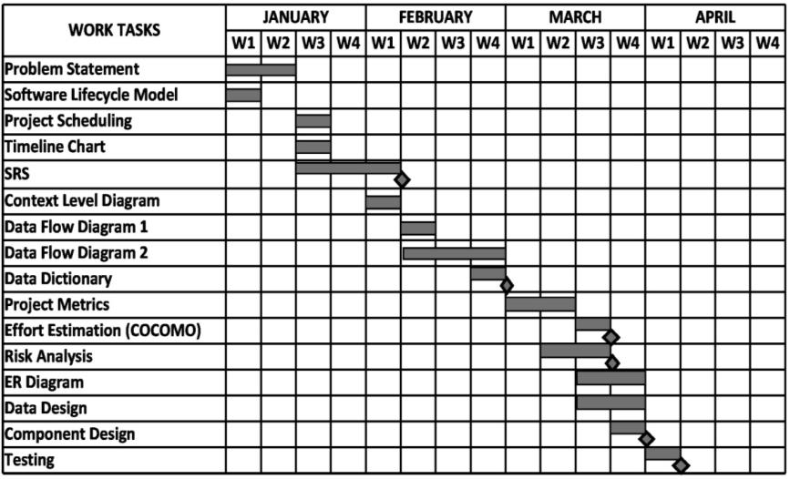
TIMELINE CHART
Notes:
Keep it brief. Make your text as brief as possible to maintain a larger font size.

Slide 24
EFFORT ESTIMATION & FP-BASED COMPUTING
Value Adjustment Factors
S.No | QUESTIONS | Value
1 | Does the system require reliable backup and recovery? | 4
2 | Are specialized data communications required to transfer the information to and from the application? | 3
3 | Are there distributed processing functions? | 3
4 | Is performance critical? | 3
5 | Will the system work in an existing heavily utilised operational environment? | 3
6 | Does the system require online data entry? | 5
7 | Does the online data entry require input transaction to be built over multiple screens or operations? | 5
8 | Are Internal Logical Files updated online? | 5
9 | Are input-output queries or files complex? | 2
10 | Is the internal processing complex? | 4
11 | Is the code designed to be reusable? | 4
12 | Are conversion and installation included in design? | 1
13 | Is the system designed for multiple installations in multiple organizations? | 3
14 | Is the application designed to facilitate changes and ease of use by the user? | 4
COUNT TOTAL (Σ Fi) |  | 49
Notes:
Keep it brief. Make your text as brief as possible to maintain a larger font size.

Slide 25
Weighting factor of information domain values
INFORMATION DOMAIN VALUES | COUNT | WEIGHING FACTOR |  |  | COUNT* WEIGHING FACTOR (SIMPLE)
 |  | SIMPLE | AVERAGE | COMPLEX
External Inputs(EI) | 48 | 3 | 4 | 6 | 144
External Outputs(EO) | 12 | 4 | 5 | 7 | 48
External Queries(EQ) | 1 | 3 | 4 | 6 | 3
Internal Logical Files(ILF) | `10 | 7 | 10 | 15 | 70
External Interface Files(EIF) | 1 | 5 | 7 | 10 | 5
TOTAL COUNT |  |  |  |  | 270
Function Point = Count total × [0.65 + 0.05 × ∑ (Fi)], where Count total= Sum of all Function Point entries
FP = 270 × [0.65 + (0.01× 49)]
= 307.80
FP = 308
Notes:
Keep it brief. Make your text as brief as possible to maintain a larger font size.

Slide 26
COST ESTIMATION:COCOMO-II MODEL
Barry Boehm gave a hierarchy of software estimation models called COCOMO i.e, COnstructive COst MOdel. This model uses sizing information for which 3 options are available which are object points, function points and lines of source code.
Complexity weighting for object types-
OBJECT TYPE | COMPLEXITY WEIGHT
 | Simple | Medium | Difficult
Screens | 1 | 2 | 3
Reports | 2 | 5 | 8
3GL Components |  |  | 10
Productivity rate for object points-
Developer’s experience or capability | Very Low | Low | Normal | High | Very High
Environment maturity or capability | Very Low | Low | Normal | High | Very High
Value | 4 | 7 | 13 | 25 | 50
Notes:
Keep it brief. Make your text as brief as possible to maintain a larger font size.

Slide 27
Object point count= Original no. of object instances*Weighing factor(Simple)
= (17*1)+(0*2)
= 17
0% of the components are re-usable.
NOP = New Object Points (or Object Point Counts)
= (Object Points)*[(100-%reuse)/100]
= 17*[(100-0)/100]
= 17
The developer’s experience and capability in a similar environment is low.
PROD (Productivity Rate) = 7
Estimated Effort = NOP/PROD
= 2.4285714
= 2.43 PM

Slide 28
RISK ANALYSIS
      ASSESSING OVERALL PROJECT RISK
1. Have top software and customer mangers formally committed to support the project? YES
2. Are end users enthusiastically committed to the project and the system / product to be built? YES
3. Are requirements fully understood by the software engineering team and its customers? YES
4. Have customers been involved fully in the definition of requirements? YES
5. Do end users have realistic expectations? YES
6. Is the project scope stable? YES
7. Does the software engineering team have the right mix of skills? YES
8. Are project requirements stable? YES
9. Does the project team have experience with the technology to be implemented? YES
10. Is the number of people on the project team adequate to do the job? YES
11. Do all customer / user constituencies agree on the importance of the project and on the requirements for the system / product to be built? YES

Slide 29
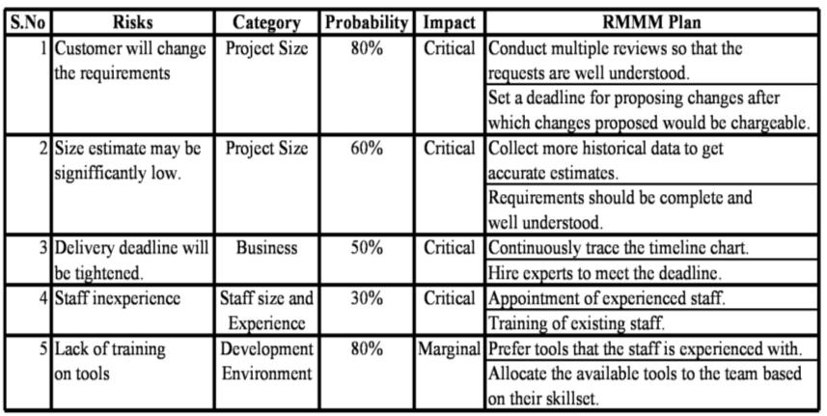
      Risk Management Table

Slide 30
DESIGN

Slide 31
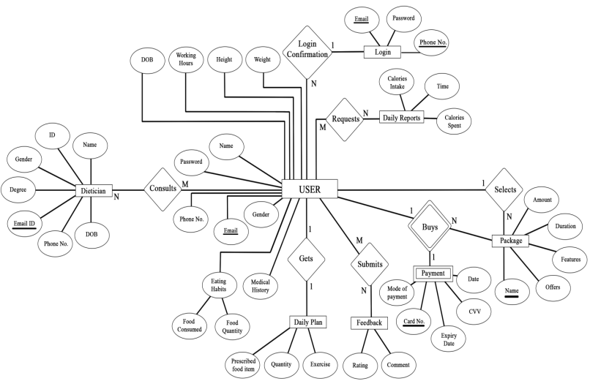
ER DIAGRAM
Notes:
This is another option for an Overview slides using transitions.

Slide 32
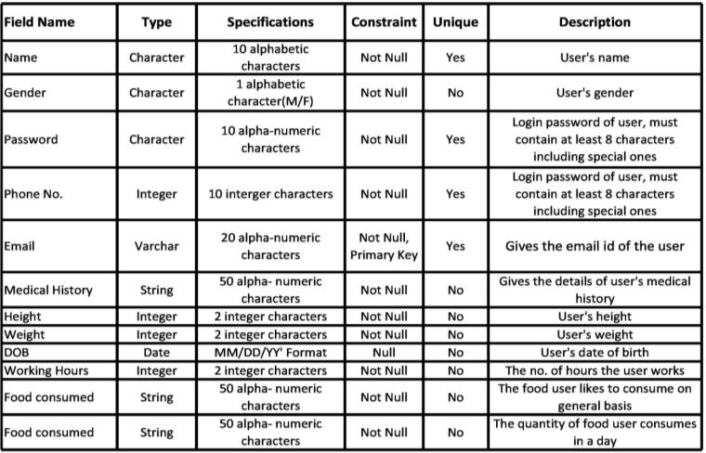
DESIGN CASES
1. USER
Notes:
This is another option for an Overview slides using transitions.

Slide 33
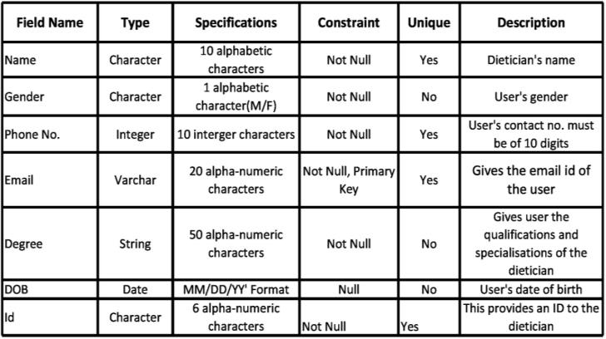
2. DIETICIAN
Notes:
This is another option for an Overview slides using transitions.

Slide 34
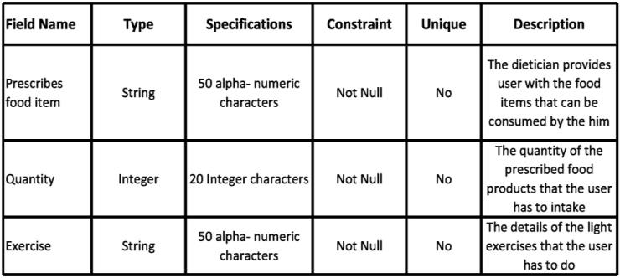
3. DAILY PLAN
Notes:
This is another option for an Overview slides using transitions.

Slide 35
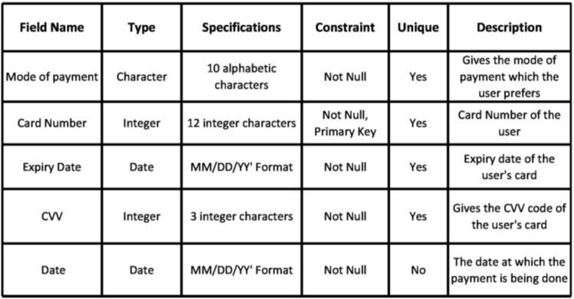
4. PAYMENT
Notes:
This is another option for an Overview slides using transitions.

Slide 36
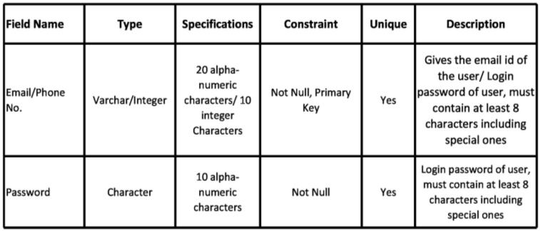
5. LOGIN
Notes:
This is another option for an Overview slides using transitions.

Slide 37
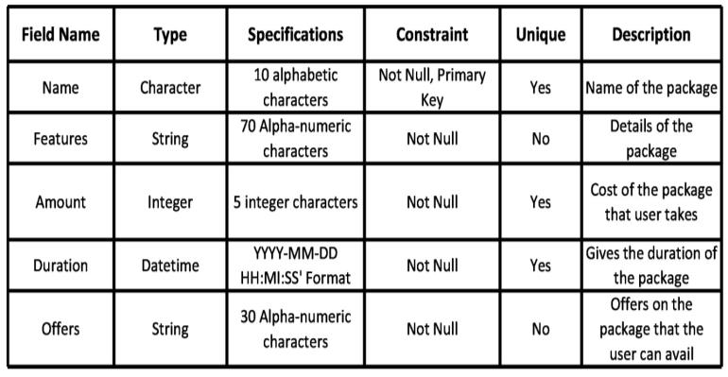
6. PACKAGE
Notes:
This is another option for an Overview slides using transitions.

Slide 38
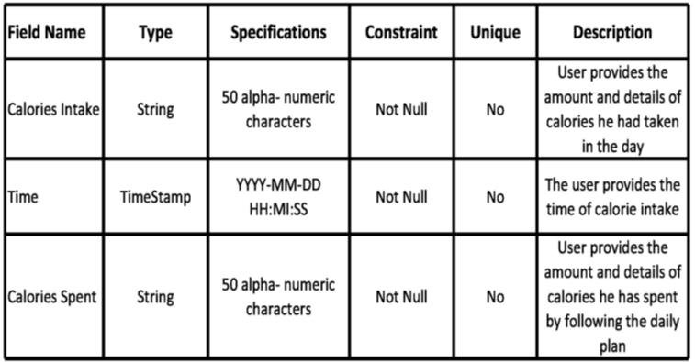
7. DAILY REPORT
Notes:
This is another option for an Overview slides using transitions.

Slide 39
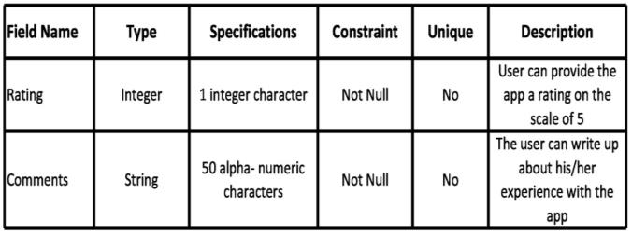
8. FEEDBACK
Notes:
This is another option for an Overview slides using transitions.

Slide 40
COMPONENT LEVEL DESIGN
Pseudocode for Select The Package module-
1. select_the_package() procedure begins
2. READ the package name, features, offers and duration from the package database
3. DISPLAY the package name, features, offers and duration
4. DO
5. GET the package name, features, offers and duration
6. STORE the package selected to the customer's database
7. PROCEED to payment screen //another module
8. WHILE select package is NULL
9. //End DO...WHILE
10. procedure ends
Notes:
This is another option for an Overview slides using transitions.

Slide 41
TESTING

Slide 42
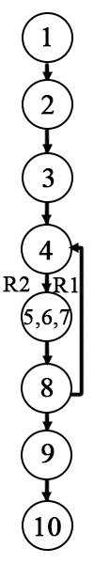
FLOWGRAPH
We are performing White Box Testing for select the package module.
Pseudocode for select the package module is-
1. select_the_package() procedure begins
2. READ the package name, features, offers and duration from the package database
3. DISPLAY the package name, features, offers and duration
4. DO
5. GET the package name, features, offers and duration
6. STORE the package selected to the customer's database
7. PROCEED to payment screen //another module
8. WHILE select package is NULL
9. //End DO...WHILE
10. procedure ends

Slide 43
CYCLOMATIC COMPLEXITY OF RESULTANT GRAPH
V (G) = Number of regions
= 2
V (G) = Edges-Nodes+2
= 8-8+2
=2
V (G) = Predicate nodes+1
= 1+1
= 2
LINEARLY INDEPENDENT PATHS FOR FLOW GRAPHS
Path 1: 1-2-3-4-5-6-7-8-9-10
Path 2: 1-2-3-4-5-6-7-8-4-5-6-7-8-9-10
TEST ID | INPUT VALUES | ACTUAL OUTPUT | EXPECTED OUTPUT
1 | Package is selected | To be observed after execution | Display the selected package
2 | Package is not selected | To be observed after execution | Show the packages to select until one is selected
Table: Test Cases Table

Slide 44
screenshots

Slide 45


EI : 0 EO : 1 EQ : 0 ILF : 0 EIF : 0
EI : 1 EO : 1 EQ : 0 ILF : 0 EIF : 0
1. Display Screen
2. Registration Screen
Notes:
This is another option for an Overview slides using transitions.

Slide 46
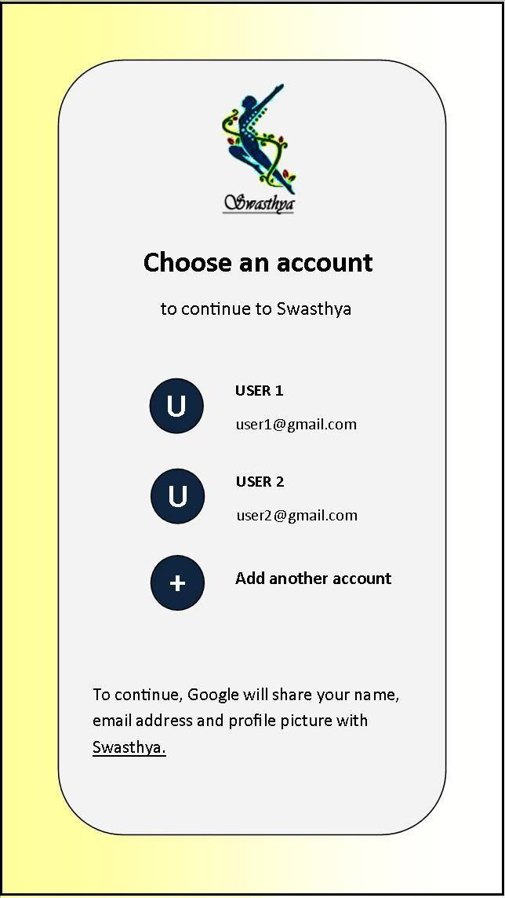
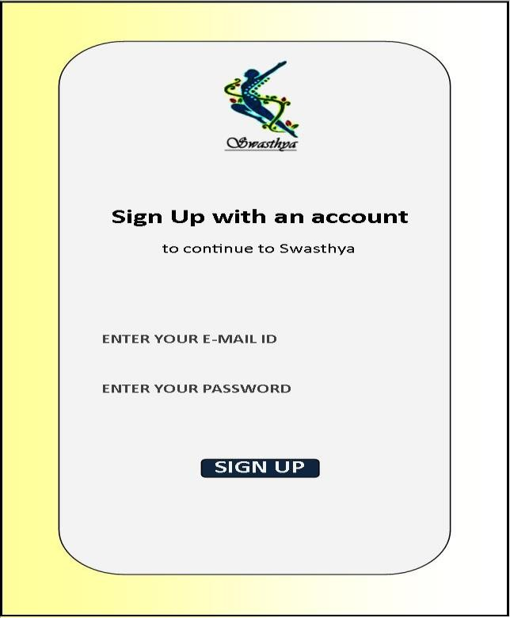
EI : 1 EO : 1 EQ : 0 ILF : 1 EIF : 0
EI : 3 EO : 1 EQ : 0 ILF : 1 EIF : 0
3. Registration Screen-1
4. Registration Screen-2
Notes:
This is another option for an Overview slides using transitions.

Slide 47
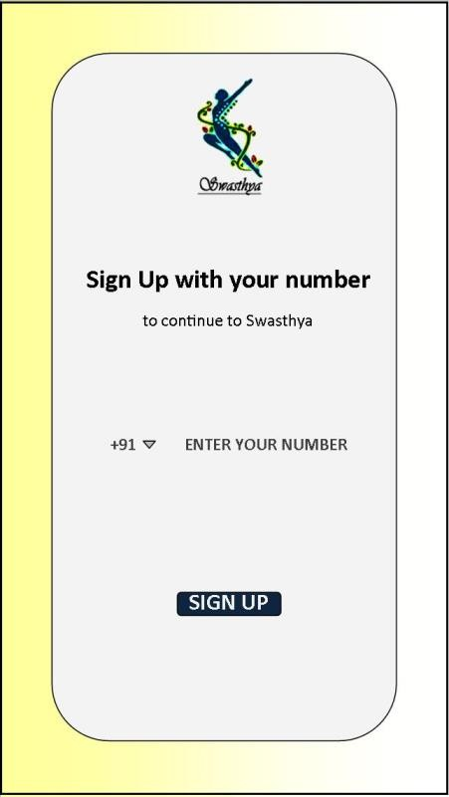
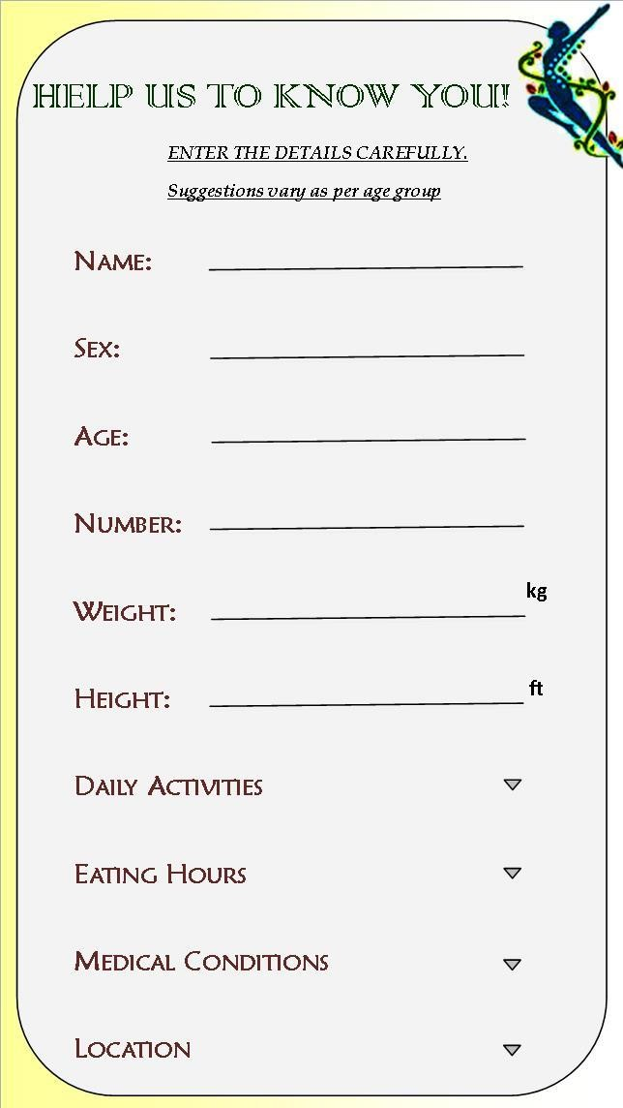
EI : 3 EO : 1 EQ : 0 ILF : 1 EIF : 0
EI : 10 EO : 0 EQ : 0 ILF : 1 EIF : 0
5. Registration Screen-3
6. Upload the Details Screen
Notes:
This is another option for an Overview slides using transitions.

Slide 48
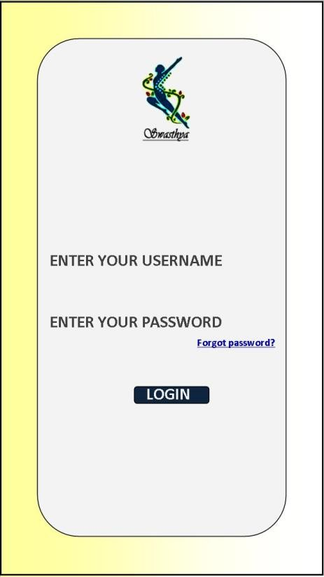
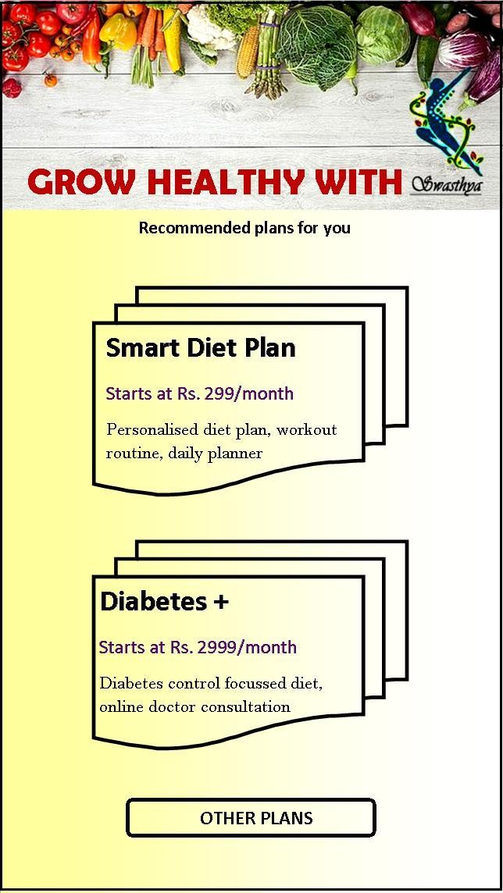
EI : 3 EO : 1 EQ : 0 ILF : 1 EIF : 0
EI : 1 EO : 1 EQ : 0 ILF : 0 EIF : 0
7. Login Screen
8. Packages Screen-1
Notes:
This is another option for an Overview slides using transitions.

Slide 49
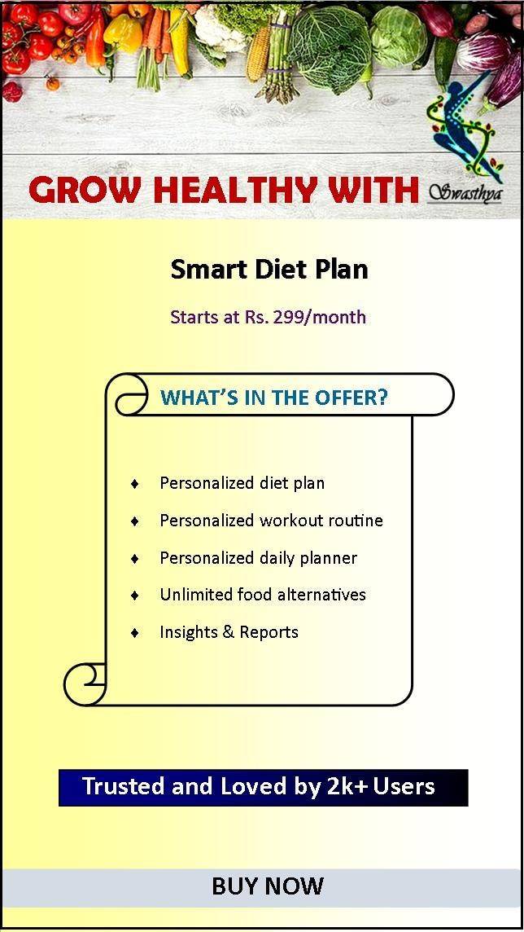
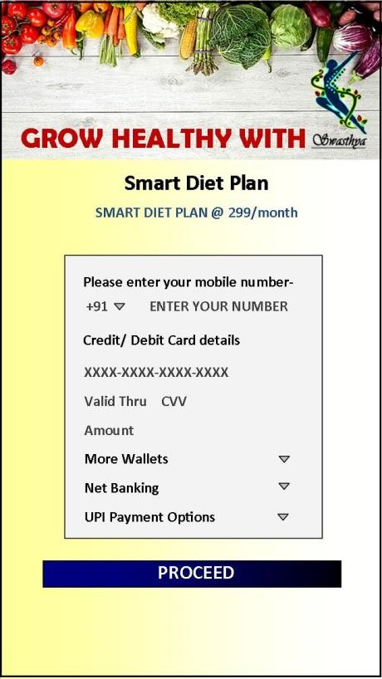
EI : 1 EO : 1 EQ : 0 ILF : 0 EIF : 0
EI : 6 EO : 0 EQ : 0 ILF : 0 EIF : 0
9. Packages Screen-2
10. Payment Screen-1
Notes:
This is another option for an Overview slides using transitions.

Slide 50
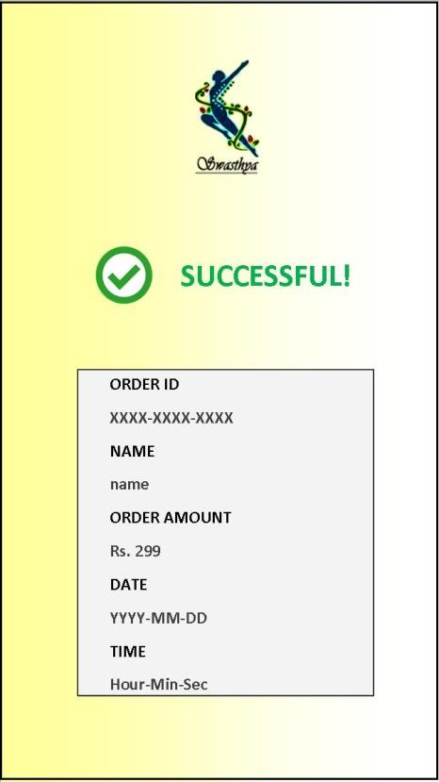
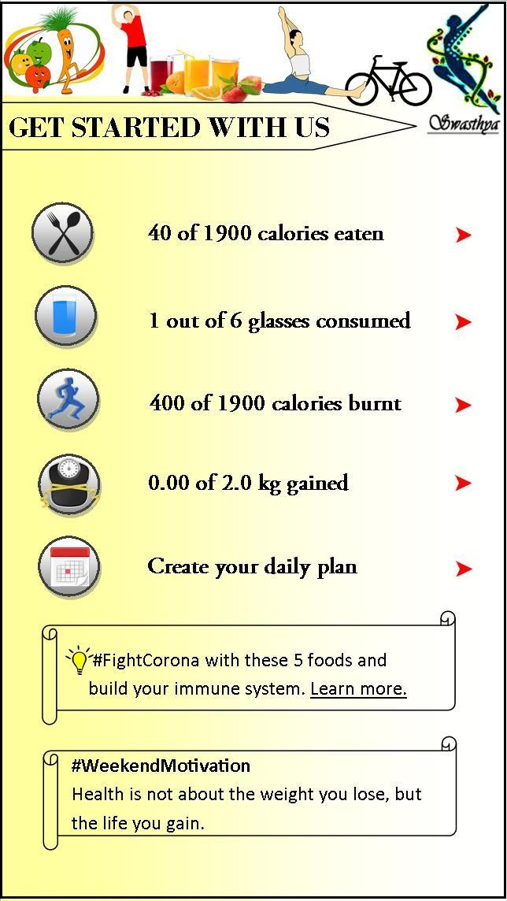
EI : 0 EO : 1 EQ : 0 ILF : 1 EIF : 0
EI : 6 EO : 1 EQ : 1 ILF : 1 EIF : 1
11. Payment Screen-2
12. Homescreen
Notes:
This is another option for an Overview slides using transitions.

Slide 51
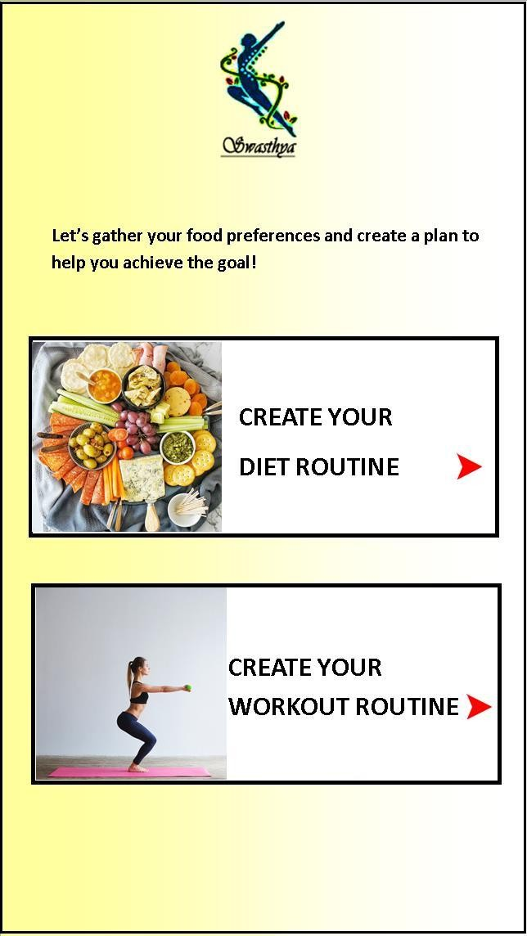
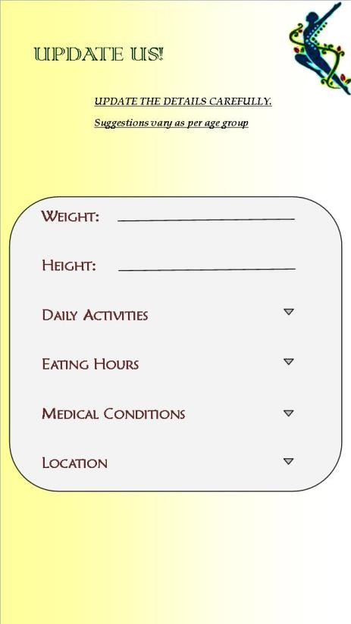
EI : 2 EO : 1 EQ : 0 ILF : 0 EIF : 0
EI : 6 EO : 0 EQ : 0 ILF : 1 EIF : 0
13. Create Plan Screen
14. Update Details Screen
Notes:
This is another option for an Overview slides using transitions.

Slide 52
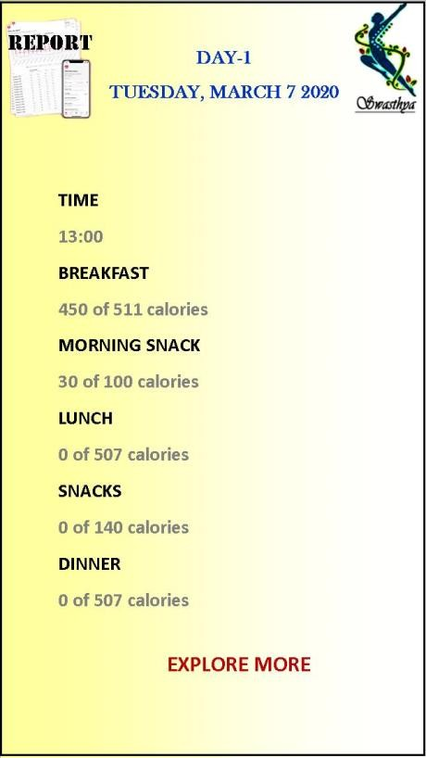
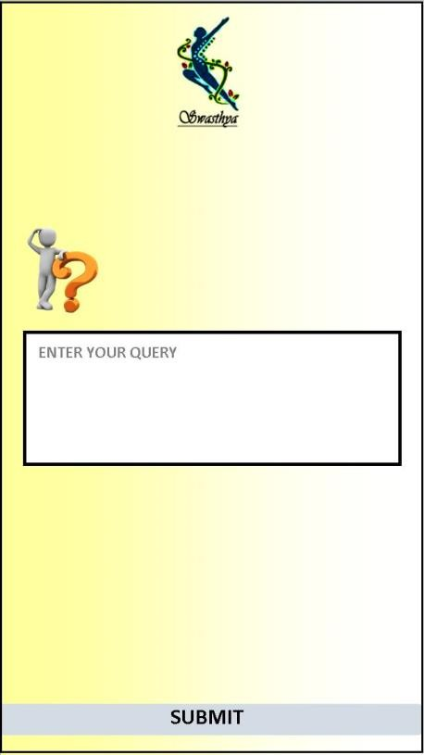
EI : 1 EO : 1 EQ : 0 ILF : 1 EIF : 0
EI : 2 EO : 0 EQ : 0 ILF : 0 EIF : 0
15. Progress Report Screen
16. Queries Screen
Notes:
This is another option for an Overview slides using transitions.

Slide 53

EI : 2 EO : 0 EQ : 0 ILF : 1 EIF : 0
17. Feedback Screen
Notes:
This is another option for an Overview slides using transitions.

Slide 54
Thank
You!
Notes:
Is your presentation as crisp as possible? Consider moving extra content to the appendix.
Use appendix slides to store content that you might want to refer to during the Question slide or that may be useful for attendees to investigate deeper in the future.

