Slide 1

Applications of R-Language

Slide 2


What is R Language?
R is a language and environment for statistical computing and graphics.
R provides a wide variety of statistical (linear and nonlinear modelling, classical statistical tests, time-series analysis, classification, clustering, …) and graphical techniques, and is highly extensible.
One of R’s strengths is the ease with which well-designed publication-quality plots can be produced, including mathematical symbols and formulae where needed. Great care has been taken over the defaults for the minor design choices in graphics, but the user retains full control.

Slide 3
Why Top Companies are using R Programming?
R is one of the latest cutting-edge tools. Today, millions of analysts, researchers, and brands such as Facebook, Google, Bing, Accenture, Wipro are using R to solve complex issues. The applications of R are not limited to just one sector, we can see the use of R in banking, e-commerce, finance, and many more sectors. This presentation will make you familiar with the real-life analogies of the R programming language.

Slide 4
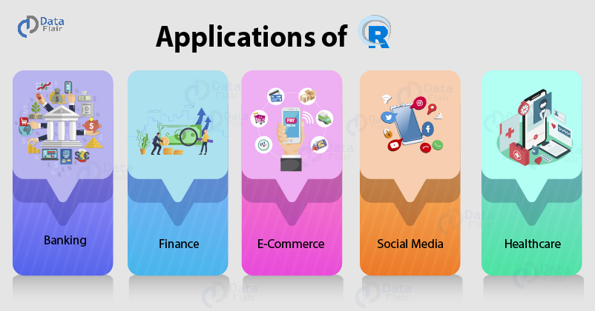
Applications of R

Slide 5
FINANCE
Data Science is most widely used in the financial industry.
R provides tools for moving averages, autoregression and time-series analysis which forms the crux of financial applications. R is being widely used for credit risk analysis at firms like ANZ and portfolio management.
BANKING
banking industries make use of R for credit risk modeling and other forms of risk analytics.
Banks make heavy usage of the Mortgage Haircut Model that allows them to take over the property in case of loan defaults.
Bank of America makes use of R for financial reporting. With the help of R, the data scientists at BOA are able to analyze financial losses and make use of R’s visualization tools.

Slide 6


HEALTHCARE
Genetics, Bioinformatics, Drug Discovery, Epidemiology are some of the fields in healthcare that make heavy usage of R. With the help of R, these companies are able to crunch data and process information, providing an essential backdrop for further analysis and data processing.
R is also popular for its Bioconductor package that provides various functionalities for analyzing the genomic data.
SOCIAL MEDIA
For many beginners in Data Science and R, social media is a data playground. Sentiment Analysis and other forms of social media data mining are some of the important statistical tools that are used with R.
Mining user sentiment is another popular category in social media analytics. With the help of R, companies are able to model statistical tools that analyze user sentiments, allowing them to improve their experiences.

Slide 7
E-COMMERCE
R is one of the standard tools that is being used in e-commerce.
Since these internet-based companies have to deal with various forms of data, structured and unstructured, as well as from varying data sources like spreadsheets and databases (SQL & NoSQL), R proves to be an effective choice for these industries.
Various statistical procedures like linear modeling are necessary to analyze the purchases made by the customers as well as in predicting product sales. Furthermore, companies use R for carrying out A/B testing analysis across the pages of their products.
MANUFACTURING
Manufacturing companies like Ford, Modelez, and John Deere use R to analyze customer sentiment. This helps them optimize their product according to trending consumer interests and also to match their production volume to varying market demand. They also use R to minimize their production costs and maximize profits.

Slide 8
Some More Applications of R
R is primarily used for descriptive statistics. Descriptive statistics summarize the main features of the data. R is used for a variety of purposes in summary statistics like central tendency, measurement of variability, finding kurtosis and skewness.
R is most widely used for exploratory data analysis. R’s most popular package ggplot2 is considered to be one of the best visualization libraries due to its aesthetics and interactivity.
R also allows hypothesis testing to validate statistical models.
You can find a correlation between the variables in R using the lm() function that is used for establishing linear regression as well as multivariable linear regression.
Moreover, with the help of R, you can develop predictive models that make use of machine learning algorithms to find the occurrences of future events.
R is also useful for developing statistical software packages and to implement analytical processing in other software suites.

Slide 9
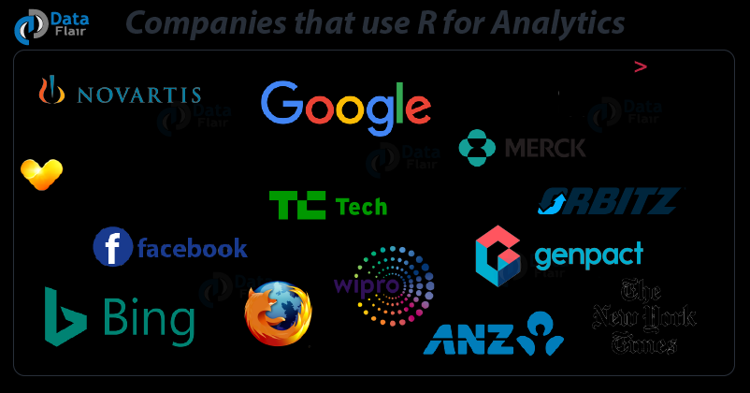
Real-Life Use Cases of R Language
Facebook – Facebook uses R to update status and its social network graph. It is also used for predicting colleague interactions with R.
Ford Motor Company – Ford relies on Hadoop. It also relies on R for statistical analysis as well as carrying out data-driven support for decision making.
Foursquare – R is an important stack behind Foursquare’s famed recommendation engine.
John Deere – Statisticians at John Deere use R for time series modeling and also geospatial analysis in a reliable and reproducible way. The results are then integrated with Excel and SAP.
New York Times – R is used in the news cycle at The New York Times to crunch data and prepare graphics before they go for printing.
ANZ Bank – ANZ, the fourth largest bank in Australia uses R for its credit risk analysis.

Slide 10
THANKYOU!!

