Slide 1

BOX PLOTTING
Sarmistha Sutar
College Roll No. : MAT/19/69
University Roll No. : 19044563024

Slide 2
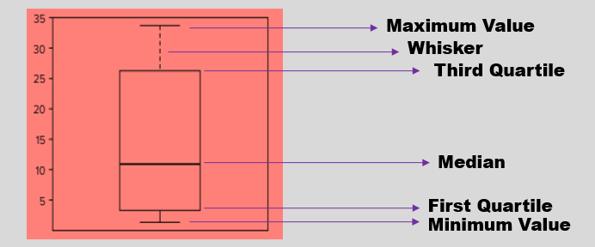
WHAT IS BOX PLOT?
Boxplot also known as Whisker Box Plot is a method for graphically depicting groups of numerical data through their quartiles.
A box plot presents a lot of information in a complete and compact manner.
Basic form of boxplot shows – median value, the quartiles and the maximium / minimum values.
boxplot() command is used to form a boxplot in R.
Simple or multiple vectors and numeric columns of a data frame can be used to form box plot.

Slide 3
USES OF BOX PLOT
Box plot is used to visualise complex data where you have multiple data sets.
It is useful for comparing samples.
We can form a boxplot for a single sample or for multiple samples.
The box-whisker plot is also useful to visualize a single sample because you can show outliers if you choose.
It is often used in explanatory data analysis.
It is used to analyse Symmetry of Data.

Slide 4
CUSTOMIZATION OF BOXPLOT IN R
We can customize and enhance the appearance of box plot by using following commands :-
names : to set the labels of boxplots which are by default 1 and 2.
xlab : to label or give title to x-axis.
ylab : to label or give title to y-axis.
range=0 : to extend the whiskers to maximum and minimum value.
col : to give colour to boxplot.
main : to give title to the boxplot
horizontal=TRUE : for horizontal box plots.

Slide 5
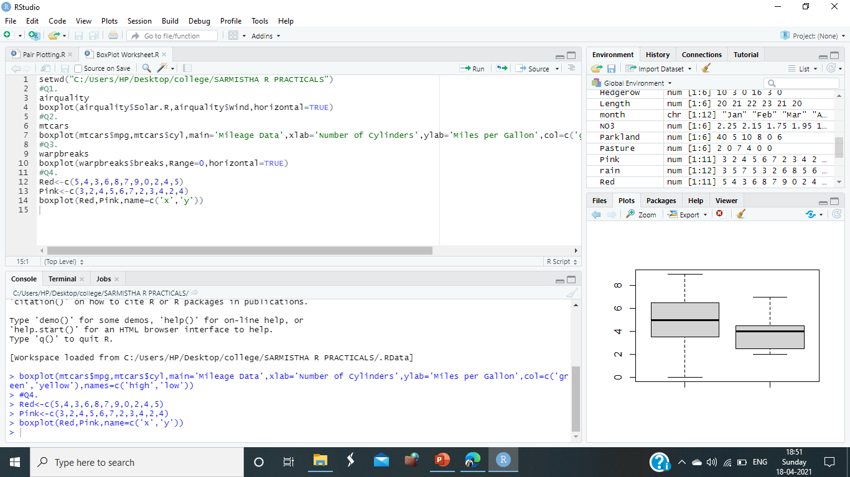
EXAMPLES OF BOX PLOT
Boxplot using vectors :-
We are given the following data: Red: 5, 4, 3, 6, 8, 7, 9, 0, 2, 4, 5 ; Pink: 3, 2, 4, 5, 6, 7, 2, 3, 4, 2, 4 ; Create boxplot for these 2 vectors. Do not give main title. And give names to the 2 components as x and y.
Command : Red<-c(5,4,3,6,8,7,9,0,2,4,5)
Pink<-c(3,2,4,5,6,7,2,3,4,2,4)
boxplot(Red,Pink,name=c('x','y’))
Output :

Slide 6
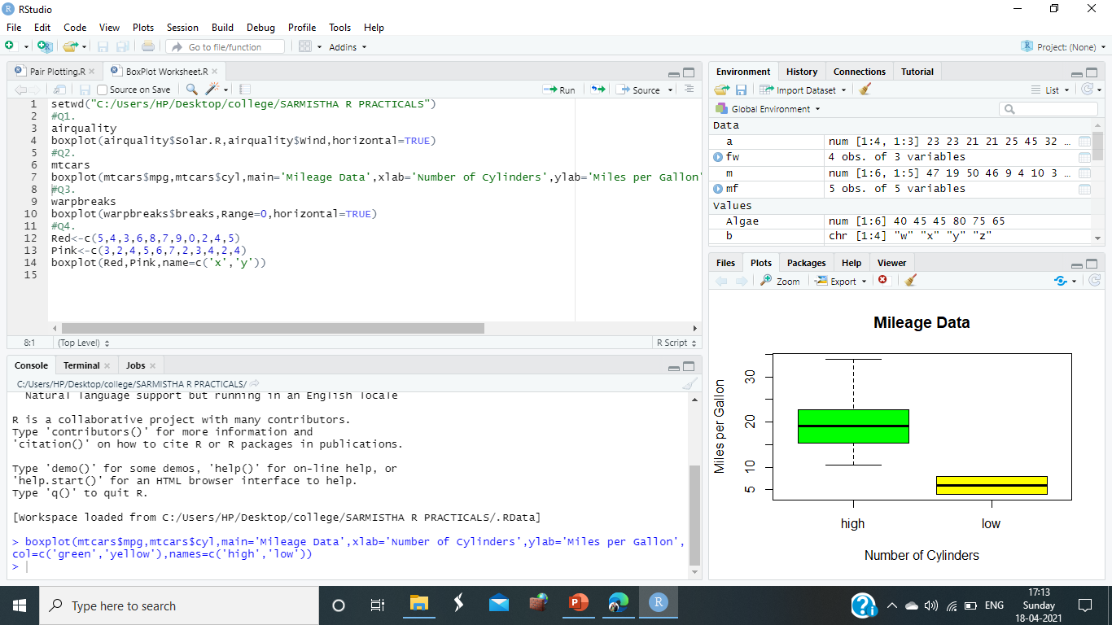
EXAMPLES OF BOX PLOT
Boxplot using numeric columns of data frame :-
Consider mtcars inbuilt data set. Draw boxplot for mpg and cyl columns. Give suitable customizations.
Command : boxplot(mtcars$mpg,mtcars$cyl,main='Mileage Data’, xlab='Number of Cylinders',ylab='Miles per Gallon’,col=c('green','yellow'),names=c('high','low’))
Output :

Slide 7
THANK
YOU!

