Slide 1

PowerPoint Presentation
on
MATHEMATICA
By – SALVI JAIN
(MAT/19/75)

Slide 2
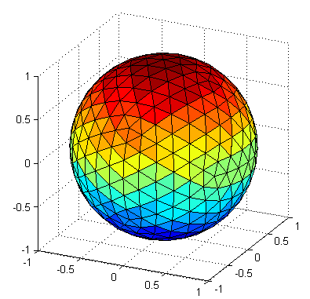
# Introduction to Mathematica
Mathematica is a computational software. It has nearly 5000 built-in
functions covering all areas of technical computing : scientific, engineering, mathematical, computing fields and statistics. The wolfram language is the programming language used in Mathematica.
# What makes it unique?
A vast system , all integrated
Unimaginable Algorithm Power
Higher level than ever before
Documents as well as code
The code makes sense
Real world Data
1,50,000+ Examples

Slide 3
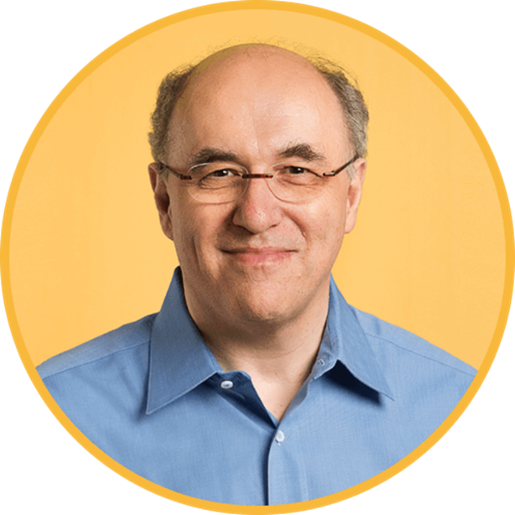
# Creator of Mathematica
STEPHEN WOLFRAM
- Born in London in 1959
- has been a pioneer in the development and application of computational thinking
- responsible for many discoveries, inventions and innovations in science, technology and business.

Slide 4
# How does Mathematica work?
NOTEBOOKS : The interaction with Mathematica is done with documents called “Notebooks”. Notebooks consists of cells that can contain texts, calculation and graphics.
Press
SHIFT
ENTER
to evaluate input,
and get output on the screen.
3 TYPES OF BRACKET USED :
{ } ( ) [ ]

Slide 5
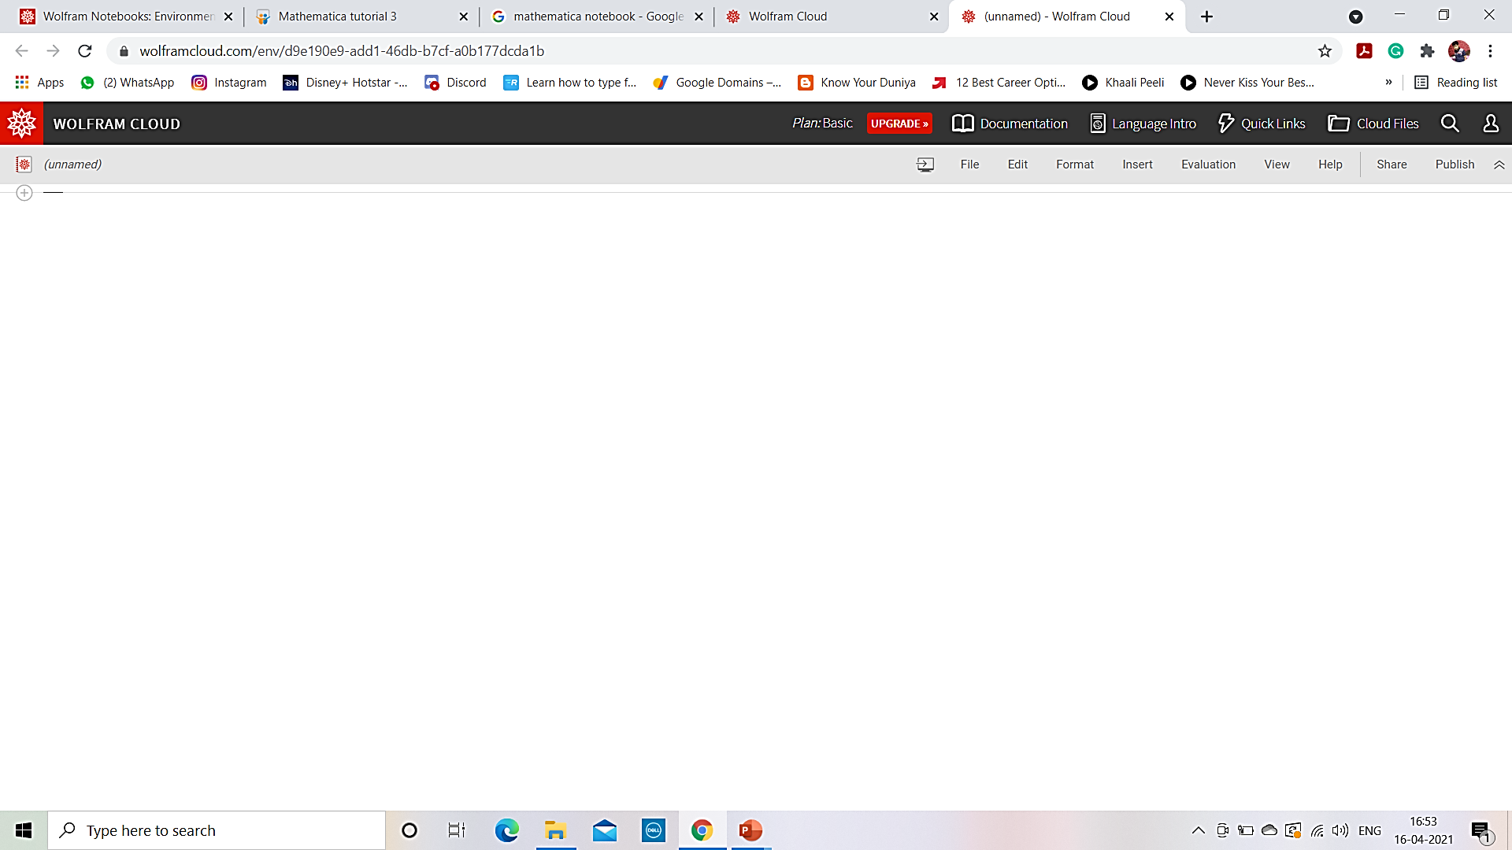
# NOTEBOOK

Slide 6
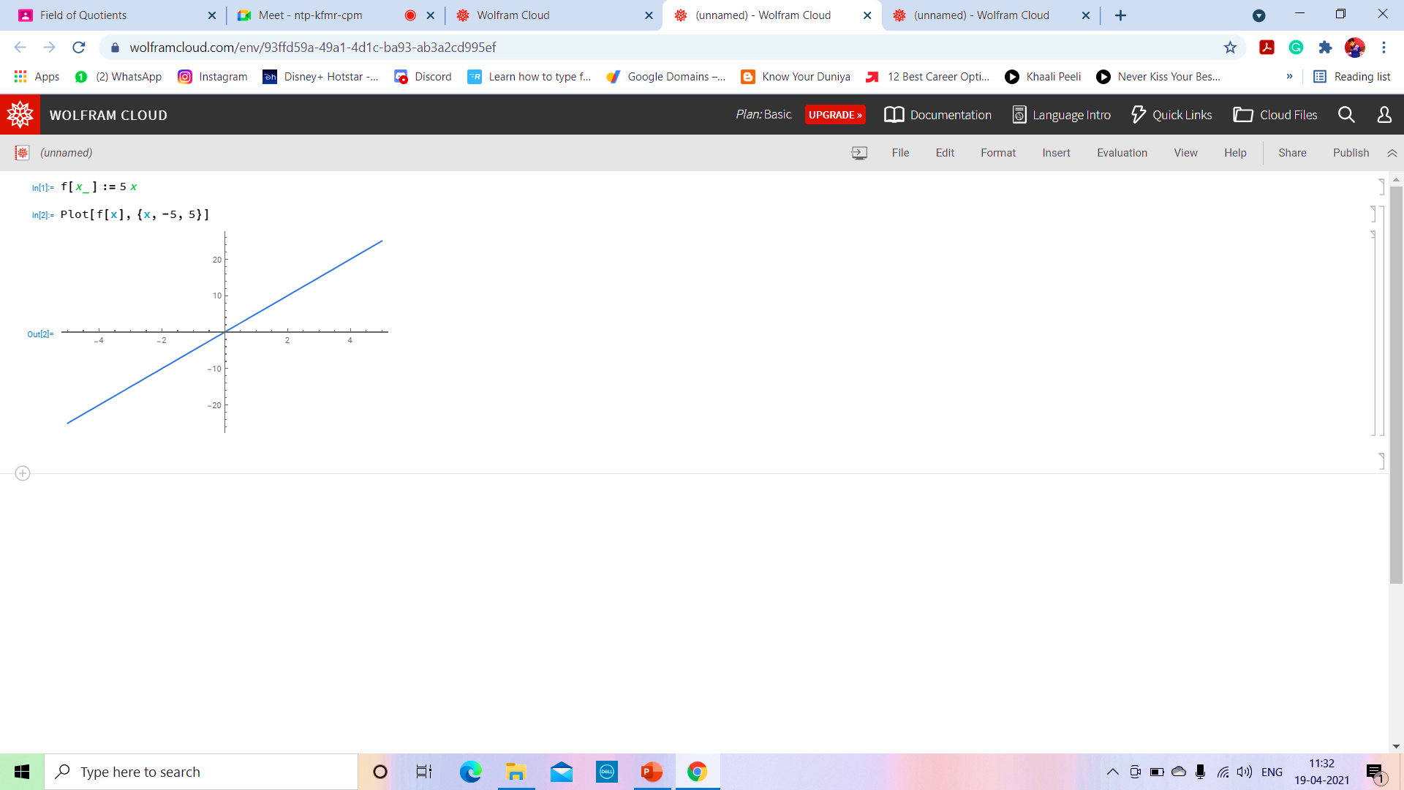
# FEATURES OF WOLFRAM
INPUT
TO CHANGE THE FONT STYLE, SIZE & ALIGNMENT
Inserting characters & symbols
OUTPUT

Slide 7
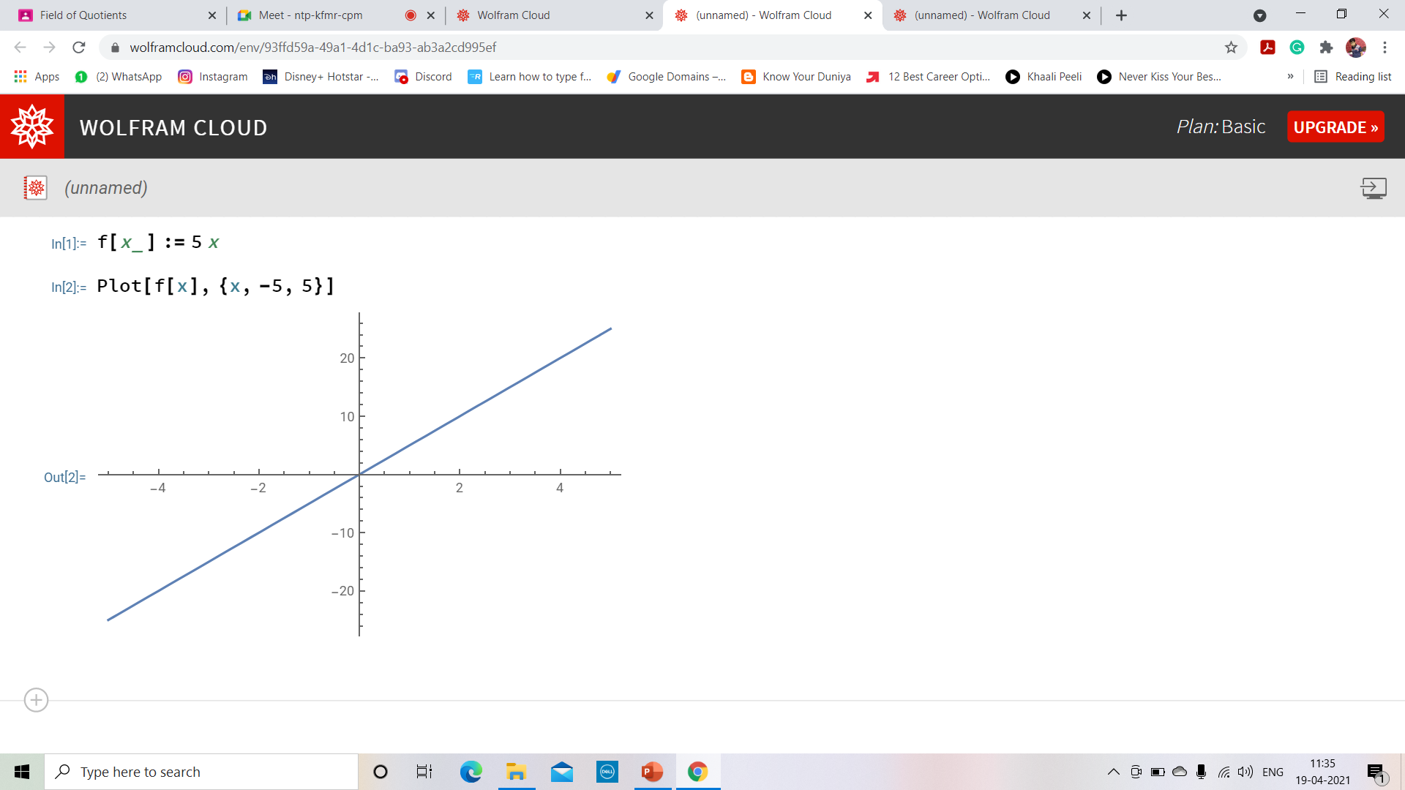
# SIMPLE GRAPH
INPUT 1
AFTER SHIFT+ENTER
INPUT 2
OUTPUT

Slide 8
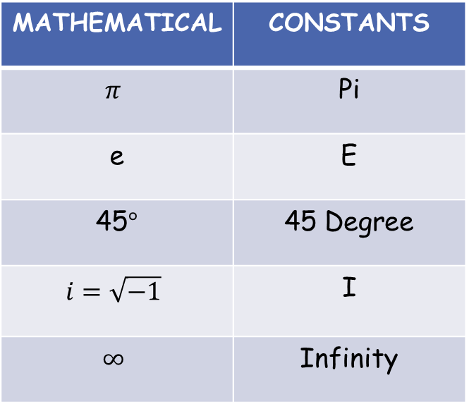
ARITHMETIC | OPERATORS
ADD/SUB | (+/-)
DIVISION | (/)
MULTIPLICATION OR SPACE | (*/.)
EXPONENTIAL | (^)
BODMAS RULE | [ () , ^ , / , * , + , - ]
MATHEMATICAL | CONSTANTS
$$π$$ | Pi
e | E
45$°$ | 45 Degree
$$i=\sqrt{−1}$$ | I
$$∞$$ | Infinity
SOME RULES
If semicolon (;) is put, output is not displayed.
For equating we always use ==
To give input value, we write (a:=5)
File is saved as file.nb

Slide 9
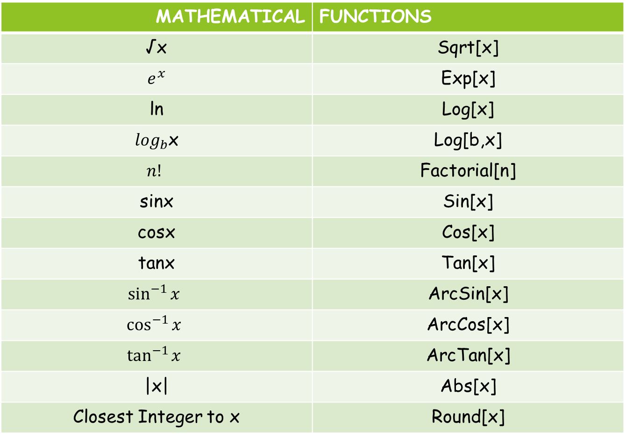
MATHEMATICAL | FUNCTIONS
√x | Sqrt[x]
$$e^{x}$$ | Exp[x]
ln | Log[x]
$\log_{b}$x | Log[b,x]
$$n!$$ | Factorial[n]
sinx | Sin[x]
cosx | Cos[x]
tanx | Tan[x]
$$\sin^{−1}{x}$$ | ArcSin[x]
$$\cos^{−1}{x}$$ | ArcCos[x]
$$\tan^{−1}{x}$$ | ArcTan[x]
|x| | Abs[x]
Closest Integer to x | Round[x]

Slide 10
# USES OF MATHEMATICA
NUMERICAL COMPUTATION
EQUATION SOLVING
SYMBOLIC CALCULATION
CALCULUS
PLOTTING GRAPHS
SELF-DEFINED FUNCTIONS
LIST
PATTERN MATCHING
ANIMATION
SOLVING DIFFERENTIAL EQUATIONS
PLOTTING PARAMETRIC CURVES
SKETCHING 3D FIGURES
AND MANY MORE….

Slide 11


