Slide 1
POLAR COORDINATES.
PRACHI GUPTA
MAT/19/87

Slide 2
What are polar coordinates?
In mathematics, the polar coordinate system is a two-dimensional coordinate system in which each point on a plane is determined by a distance from a reference point and an angle from a reference direction.

Slide 3
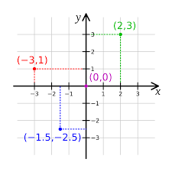
What are cartesian coordinate ?
A Cartesian coordinate system in a plane is a coordinate system that specifies each point uniquely by a pair of numerical coordinates, which are the signed distances to the point from two fixed perpendicular oriented lines, measured in the same unit of length.

Slide 4
Relation between cartesian and polar co-ordinates.
Here we will learn to find the relation between Cartesian and Polar Co-Ordinates.
Let XOX’ and YOY’ be a set of rectangular Cartesian axes of polar Co-ordinates through the origin O. now, consider a polar Co-ordinates system whose pole and initial line coincide respectively with the origin O and the positive x-axis of the Cartesian system. Let P be any point on the plane whose Cartesian and polar Co-ordinates are (x, y) and (r, θ) respectively. Draw PM perpendicular to OX. Then we have,

Slide 5
OM = x, PM = y, OP = r and < MOP = θ
Now, from the right-angled triangle MOP we get,
x/r = cos θ or, x = r cos θ …… (1)
and y/r = sin θ or, y = r sin …… (2)
Again, from the right angled triangle OPM we get,
r² = x² + y²
or, r = √(x² + y²) …… (3)
and tan θ = y/x or, θ = tan[Math Processing Error]−1 y/x ……… (4)
Using (3) and (4) we can find the polar Co-ordinates (r, θ) of the points whose Cartesian Co-ordinates (x, y) are given.

Slide 6
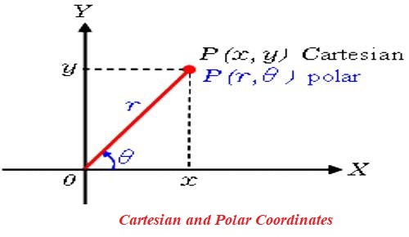

Slide 7
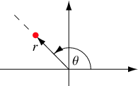
The polar coordinates r (the radial coordinate) and (the angular coordinate, often called the polar angle) are defined in terms of Cartesian coordinates by
X = r cos θ
Y = r sin θ
where is the radial distance from the origin, and is the counterclockwise angle from the x-axis. In terms of x and y.
r = (x² + y²) ½
θ = Arctan( y / x)
 |  |  | (1)
 |  |  | (2)
 |  |  | (3)

Slide 8
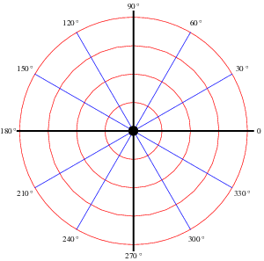
Angle analysis.

Slide 9
What Are Some Examples of Real-Life Uses of Polar Coordinates?
Some of the real-life uses of polar coordinates include avoiding collisions between vessels and other ships or natural obstructions, guiding industrial robots in various production applications and calculating groundwater flow in radially symmetric wells. Polar coordinates can also be used to determine the best audio pickup patterns for cardioid microphones. Calculations involving aircraft navigation, gravitational fields and radio antennae are additional applications in which polar coordinates are used

Slide 10
The cartesian co-ordinates of a point are (- 1, -√3); find its polar co-ordinates.
If the pole and initial line of the polar system coincide with the origin and positive x-axis respectively of the cartesian system and the cartesian and polar co-ordinates of a point are ( x, y ) and ( r, θ ) respectively, then
x = r cos θ and y= r sin θ.
In the given problem, x = -1 and y = -√3
Therefore, r cos θ = -1 and r sin θ = -√3
Therefore, r² Cos² θ + r² sin² = (- 1)² + (-√3)²
And tan θ = (r sin θ)/(r cos θ) = (-√3)/(-1) = √3 = tan π/3
Or, tan θ =tan(π+ π/3) [Since, the point (- 1, – √3) lise in the third quadrant]
Or, tan θ = tan 4π/3
Therefore, θ = 4π/3
Therefore, the polar co-ordinates of the point
(- 1, – √3) are (2, 4π/3).

Slide 11
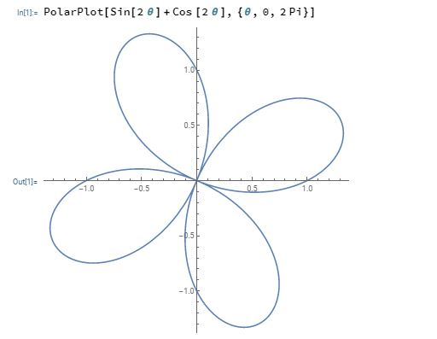
Create a 2 D polar plot.

Slide 12
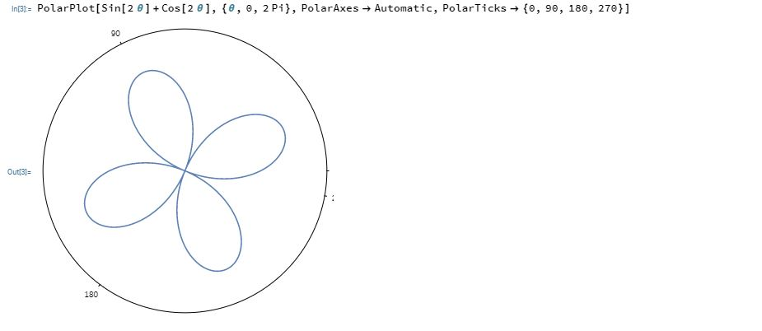
Display polar axis.

Slide 13
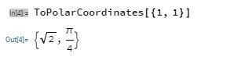
Cartesian to polar

Slide 14
Thank
You

