Slide 1

Submitted by:
Mahek Khurana : MAT/19/63
Priya Tyagi : MAT/19/64
Submitted to :
Dr. Ramita Sahni Ma’am

Slide 2

R Presentation
Topic : Lists
1. Introduction to lists
6. Some Basic Commands
2. Predefined lists in R
7. Changing lists elements
3. Naming of list element ,structure and length of the list
8. Adding and removing list elements
4. Checking the existence of list elements
9. Joining two lists
5. Accessing elements of lists
10. Converting list to Vector

Slide 3


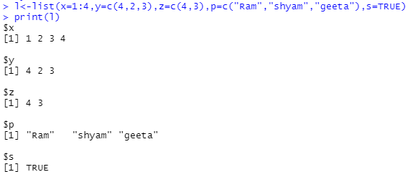
Introduction to Lists :
Lists : List is one dimensional data structures with different type of objects . R list can also contain a matrix or a function as it’s element .
It is made up of different type of vectors.
List is created using command List ( ) function in R.
INPUT
OUTPUT
[ Note : Always use = inside the list ]

Slide 4


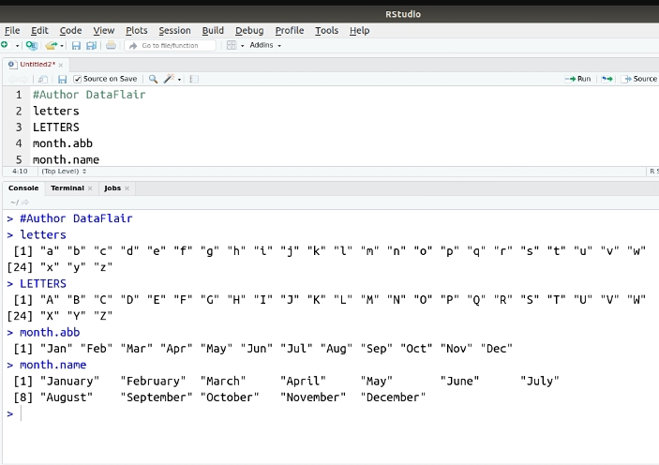
Predefined List :
We also have some predefined lists
in R for example List for Letters and
month names are predefined.
letters
LETTERS
Month.abb
Month.name

Slide 5


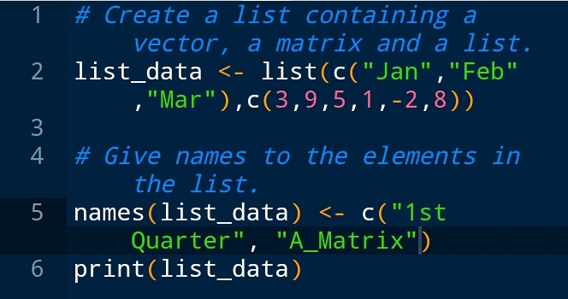
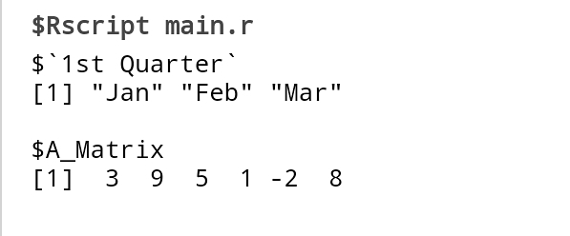
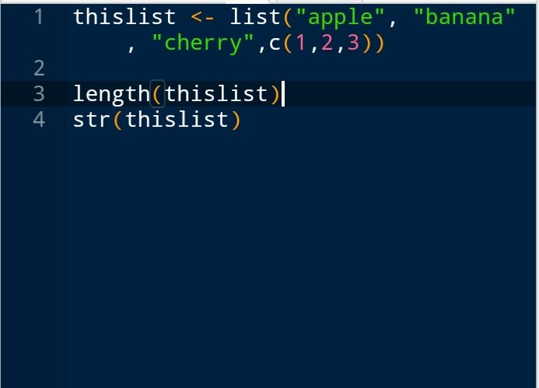
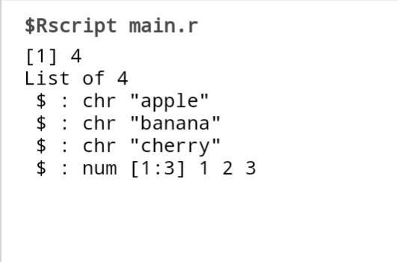
Structure and Length of a list
Naming of List’s elements
We can give name to the elements of list using command names()<-c(“ “, “ “) command
Structure : tell us type of elements of the list using the command str( ).
Length: tell us number of the elements of the list Using the command length ( ),

Slide 6


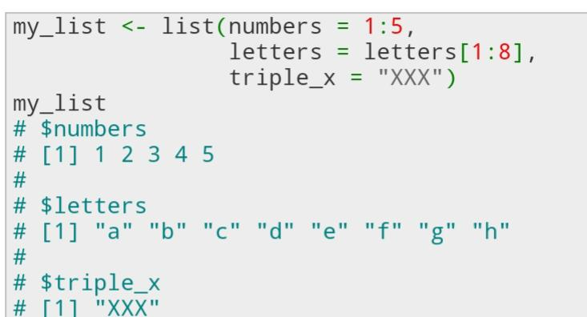
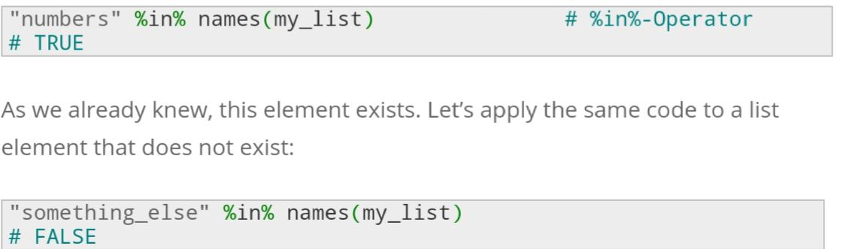
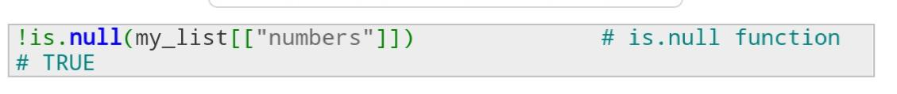
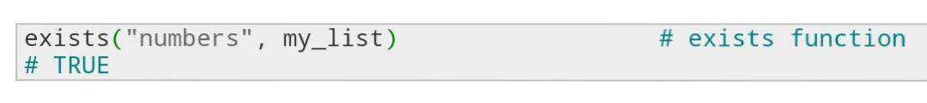
.
Checking of existence of List’s elements :
There are three ways of finding this .
%in%-Operator
Is.null Function
exists Function
1
2
3

Slide 7


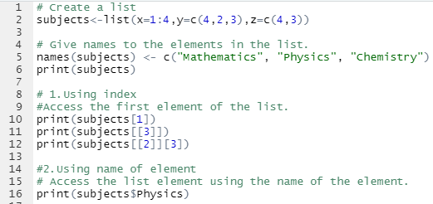
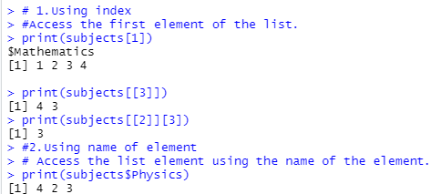
Accessing elements of lists:
Accessing list elements : You can access the list items anytime by referring to its index number, inside single or double square brackets. The first element has index 1, the second element has index 2, and so on. In case of named lists it can also be accessed by the names using “$”.
INPUT
OUTPUT
OUTPUT

Slide 8

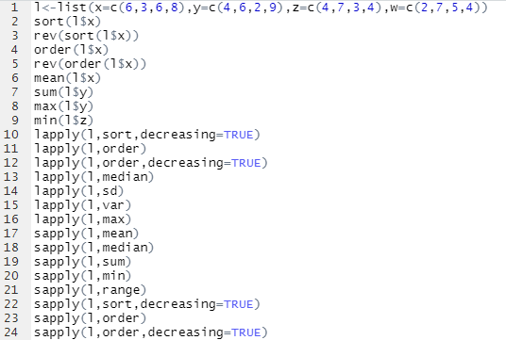
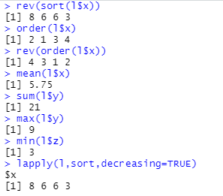
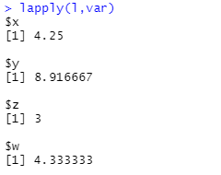
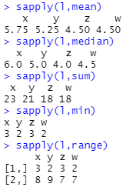
Basic Commands :
OUTPUT
INPUT

Slide 9


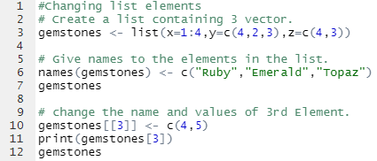
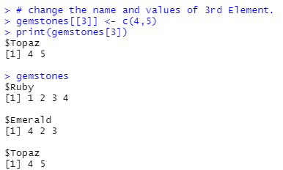
Changing list elements :
Changing list elements : To change the value of a specific element, we can refer to their index number for example to change the 1st element whose index is 1 first write the name of the list followed by the index number written in single or double square brackets and then with the help of assignment operator assign the new value to that particular element of list .
INPUT
OUTPUT

Slide 10


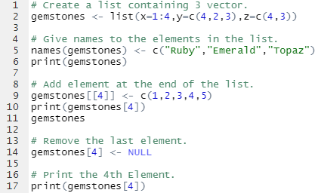
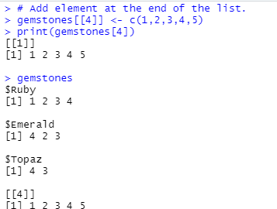

Adding and Removing list elements :
Adding new element : We can add a new element to a list by assigning it to an unused index.
Removing list element : We can delete a element of a list by reassigning it to NULL.
OUTPUT
INPUT

Slide 11


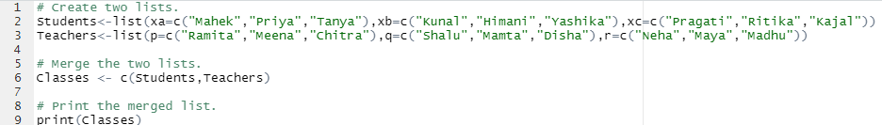
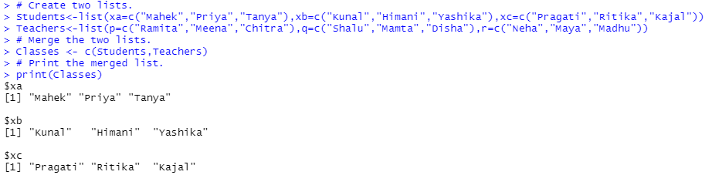
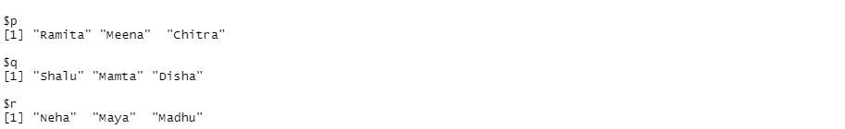
Joining two lists :
Joining two or more lists : There are several ways to join, or concatenate, two or more lists in R.
The most common way is to use the c() function, which combines two lists together:
INPUT
OUTPUT

Slide 12


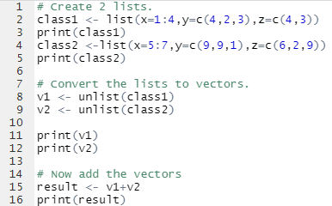
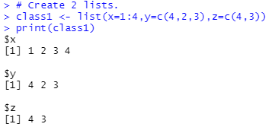
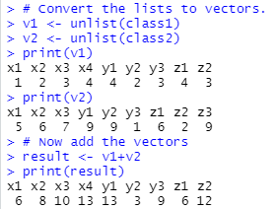
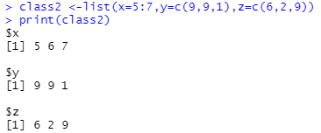
Converting list to Vector :
Converting : A list can be converted to a vector so that the elements of the vector can be used for further manipulation. All the arithmetic operations on vectors can be applied after the list is converted into vector. To do this conversion, we can use the unlist() function. It takes the list as input and produces a vector.
OUTPUT 1
INPUT
OUTPUT 2

Slide 13



