Slide 1
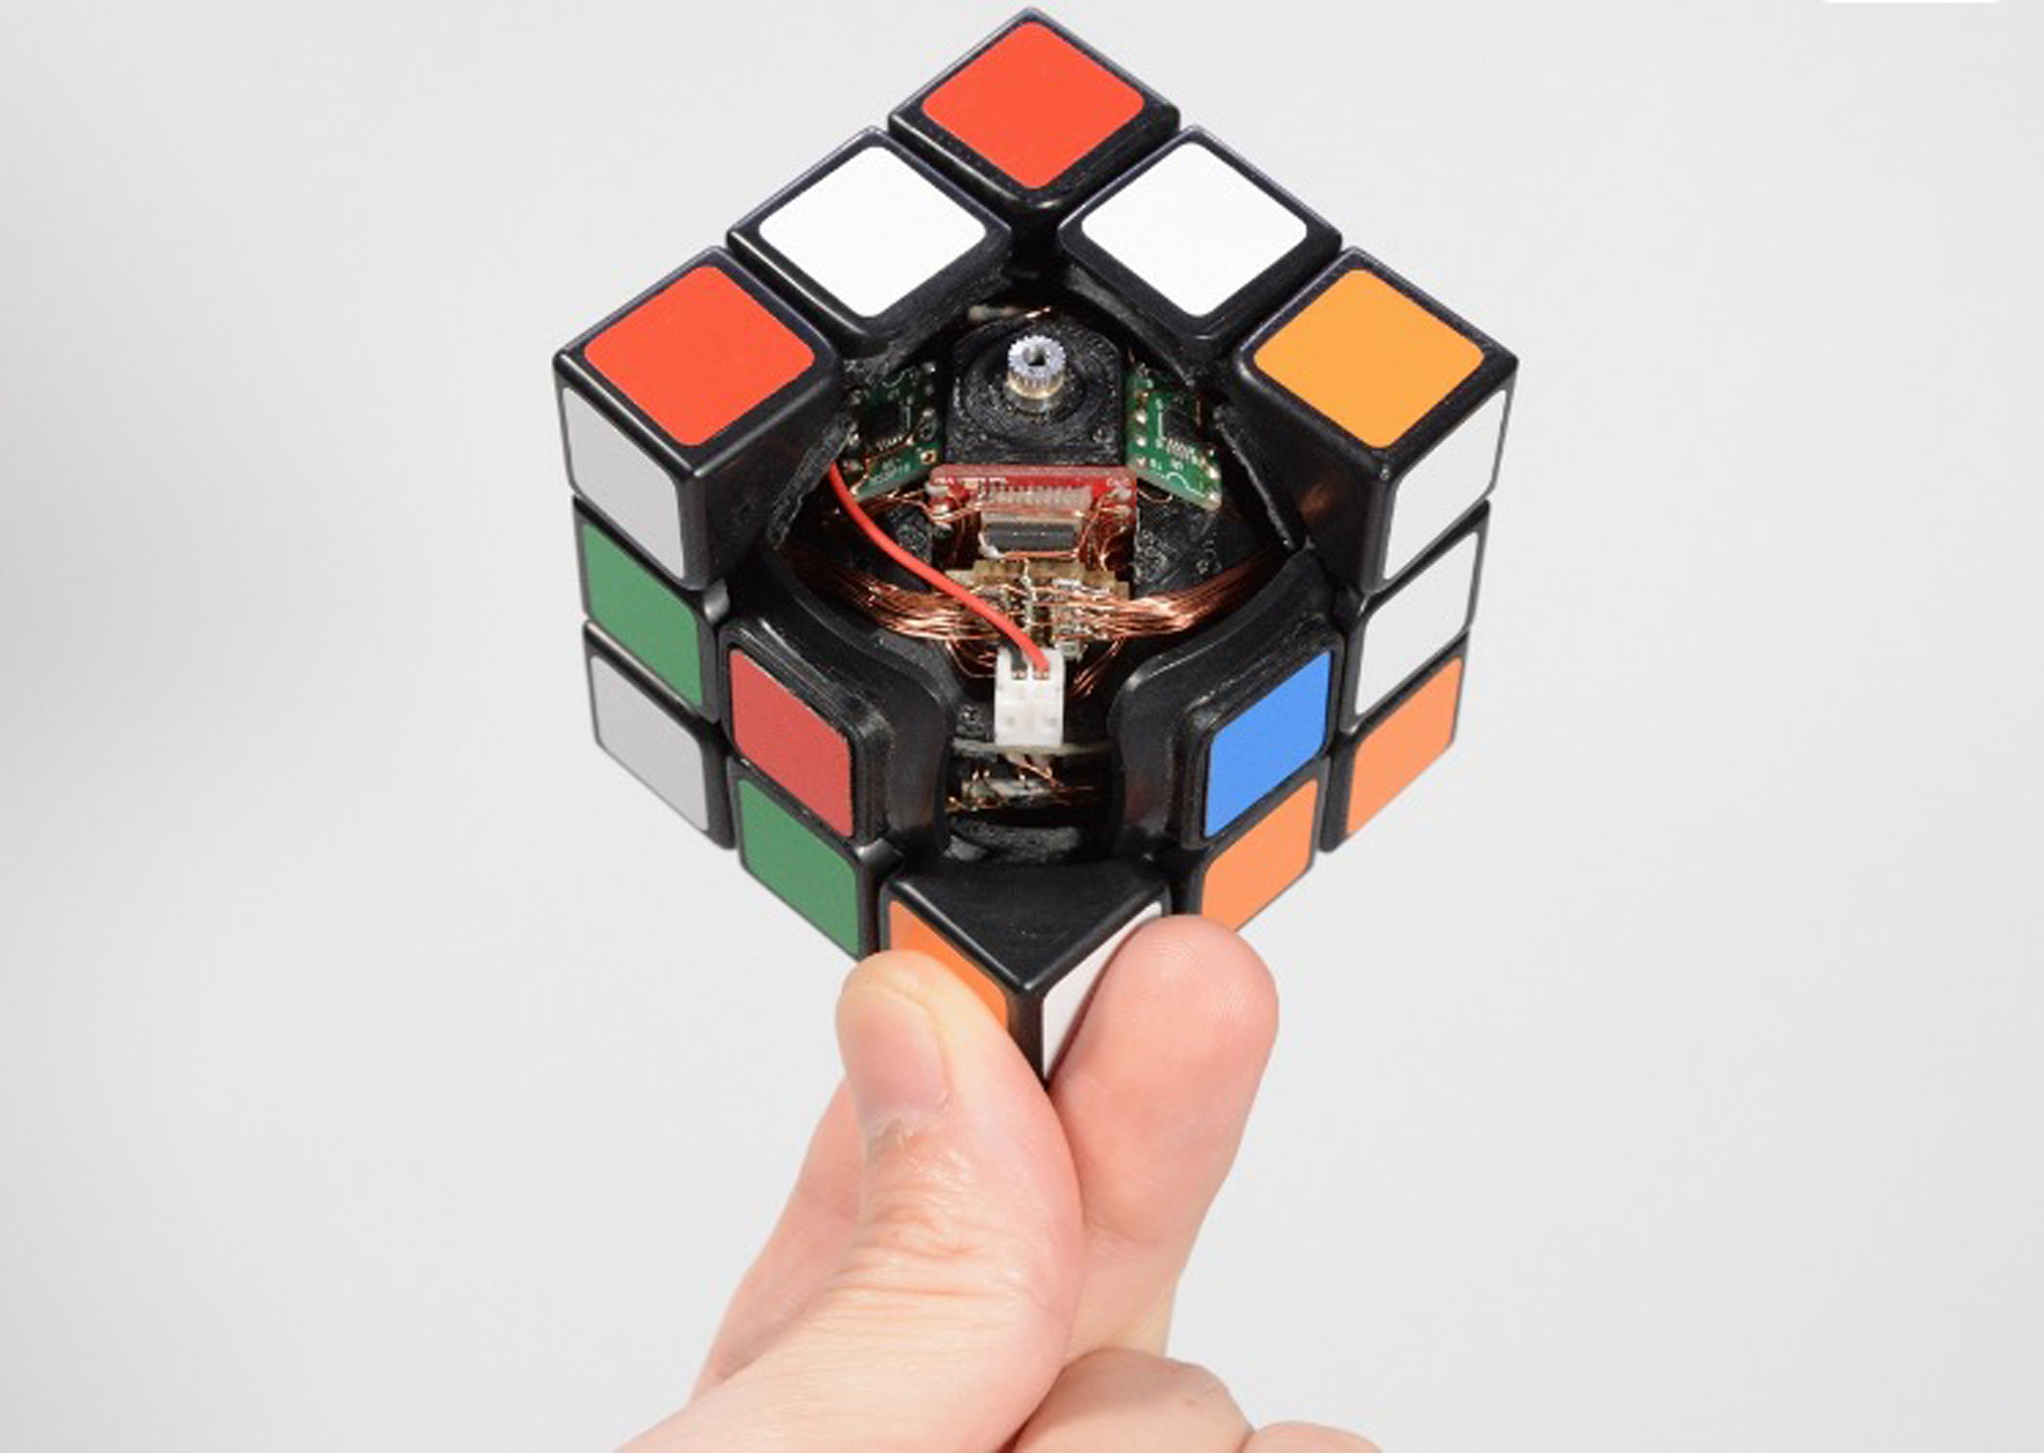
RUBIK’S CUBE
RIDIMA BADOLA
MAT/19/102

Slide 2
INTRODUCTION:
The Rubik’s Cube is a 3 × 3 × 3 cube. The cube can be manipulated by rotating the
faces of the cube. There are six faces, with each face composed of nine facets. On each
face, the center facet is fixed, and is unmoveable. In total, there are 6 · 9 = 54 facets on
the cube. Each facet is also colored, and solving the cube requires that each face be a
solid color. That is, the nine facets of the side must all be the same color. When the cube was first introduced to the public, the focus was on solving the puzzle.

Slide 3
Today, the Rubik’s Cube is still popular; however, the focus has changed. Speed-cubing competitions are held through the World Cube Association, where participants attempt to solve the cube as fast as possible.
There is also interest in finding the maximum number of minimum moves needed to put the cube into its solved state from any position. This number is called God’s Number and in 2010 was determined to be 20 . God’s Number, however, does not say which twists and turns are needed to solve the cube, it merely states what the maximum number of moves is.

Slide 4
MATHEMATICS OF SOLVING THE RUBIK’S CUBE:
The number of possible permutations of the squares on a Rubik’s cube seems daunting. There are 8 corner pieces that can be arranged in 8! ways, each of which can be arranged in 3 orientations, giving 38 possibilities for each permutation of the corner pieces. There are 12 edge pieces which can be arranged in 12! ways. Each edge piece has 2 possible orientations, so each permutation of edge pieces has 212 arrangements.

Slide 5
But in the Rubik's cube, only 1/3 of the permutations have the rotations of the corner cubies correct. Only ½ of the permutations have the same edge flipping orientation as the original cube, and only ½ of these have the correct cubie rearrangement parity, This gives:
(8! . 3⁸. 12! . 2¹² ) = 4.3252.10¹⁹
(3.2.2)
possible arrangements of the Rubik’s cube. It is not completely known how to find the minimum distance between two
arrangements of the cube. Of particular interest is the minimum number of moves from any permutation of the cube’s cubies back to the initial solved state.

Slide 6
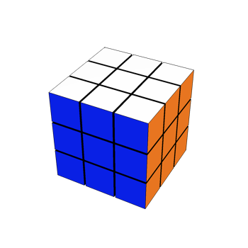
COMMANDS
Let’s start with the command to layout a simple rubik’s cube:
Command: new=RubiksCube[]
Visualize it: new@”Show”[]
Output:

Slide 7
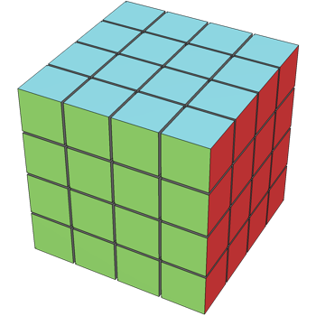
Now we will define the size and the color of the cube
Command: r1=RubiksCube[“Size”-> 4];
r1@”Colors”= ColorData[“Atoms”]/@{6,7,8,9,11,13,18};
r1@”Show”[Method->{“ShrinkWrap”-> True}]
Output:

Slide 8
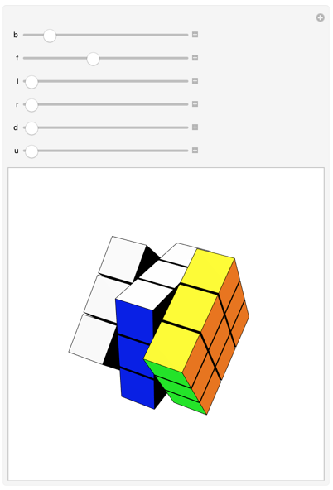
Making use of Manipulate Command
Command: Manipulate[Fold[#@”Twist”[#2[[1]], #2[[2]] &, new, Thread[{{b,f,l,r,d,u},{“Back”,”Front”,”Left”,”Right”,”Down”,”Up”}}]]@”Show”[],
{b,0,2?,.01},{f,0,2?,.01},{l,0,2?,.01},{r,0,2?,.01},{d,0,2?,.01},{u,0,2?,.01},
DisplayAllSteps->True]
Output:

Slide 9
THANK YOU

