Slide 1

R is a programming language and environment for statistical computing and graphics.
A variety of graphs is available in R, and the use is solely governed by the context. However, exploratory analysis requires the use of certain graphs in R, which must be used for analyzing data.
Some Graphs in R are :
Boxplot
Scatter Plot
Histograms
Bar Graphs
Line Charts
Dot Plot
Now we will focus into the type of graph namely LINE CHART

Slide 2
LINE CHART
A line chart is a graph that connects a series of points by drawing line segments between them. Line charts are usually used in identifying the trends in data.
The plot() function in R is used to create the line graph.
The basic syntax to create a line chart in R is −
plot(v, type, col, xlab, ylab)
Following is the description of the parameters used −
v is a vector containing the numeric values.
type takes the value "p" to draw only the points, "l" to draw only the lines and "o" to draw both points and lines.
xlab is the label for x axis.
ylab is the label for y axis.
main is the Title of the chart.
col is used to give colors to both the points and lines.
NOTE : Data considered is mostly numeric
Line Chart is usually produced for time series data

Slide 3
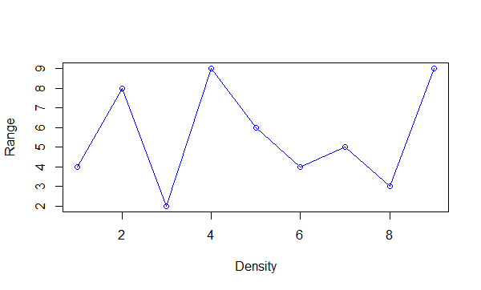
Example : x<-c(4,8,2,9,6,4,5,3,9)
plot(x,type='o',col='blue',xlab='Density',ylab='Range')
OUTPUT
2. y<-c("ram","flower","tin")
plot(y,type='o',col='blue',xlab='Density',ylab='Range')
OUTPUT
Error in plot.window(...) : need finite 'ylim' values
In addition: Warning messages:
1: In xy.coords(x, y, xlabel, ylabel, log) : NAs introduced by coercion
2: In min(x) : no non-missing arguments to min; returning Inf
3: In max(x) : no non-missing arguments to max; returning –Inf
DATA CONSIDERED IS USUALLY NUMERIC

Slide 4
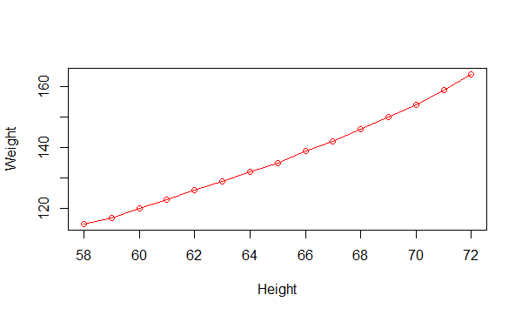
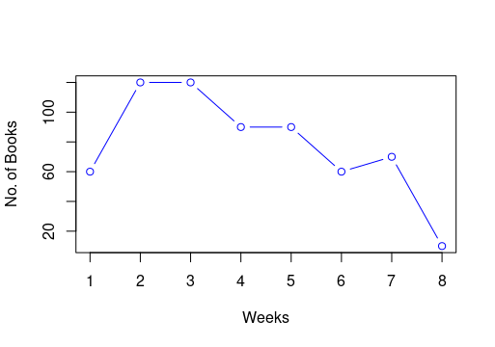
3. Women -> Inbuilt data set in R
plot(women,type='o',col='red',xlab='Height',ylab='Weight')
4. A line graph of the number of books sold per week during a certain period.
m<-c(1:8)
n<-c(60,120,120,90,90,60,70,10)
plot(m,n,type='b',col='blue',
xlab='Weeks,ylab='No. of Books')

Slide 5
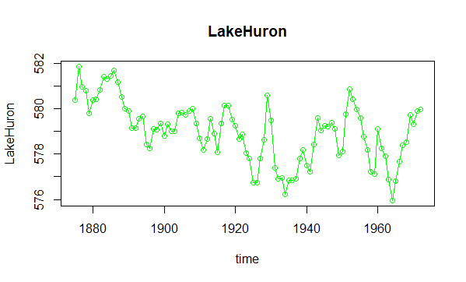
Consider an inbuilt time series “LakeHuron” in R
plot(LakeHuron,type='o',col='green',main='LakeHuron',xlab='time',ylab='LakeHuron')
It represents the annual measurements of the level of water, in feet, of Lake Huron from 1875–1972.

Slide 6
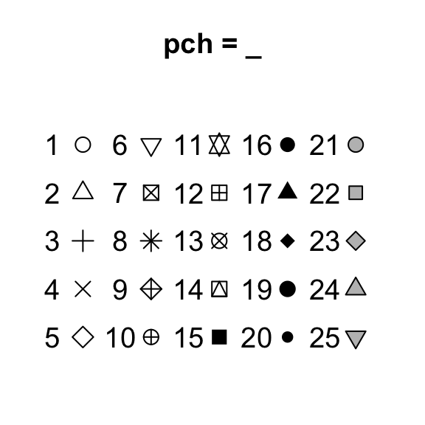
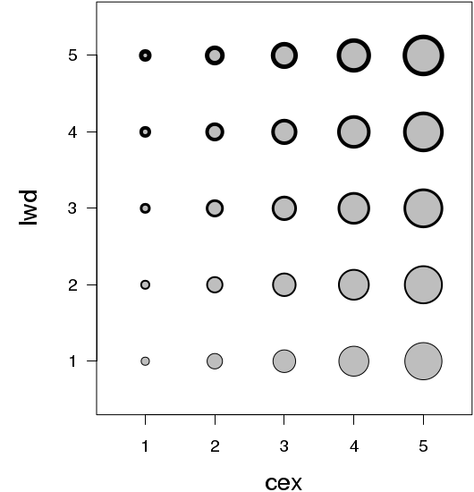
Plotting Symbols
We can use many other graphical parameters to modify the plot.This is useful when we want to add more points to the graph.The pch = instruction refers to the plotting characters.We can type an integer value and this code will be reflected in the symbol/character produced.From values from 0 to 25,we get symbols shown below:
We can alter the size of the plotted characters using the cex = instruction; this is a character expansion factor. So setting cex = 2 makes point twice as large as normal and cex = 0.5 makes them half normal size.
To change line width, lwd can be used.

Slide 7
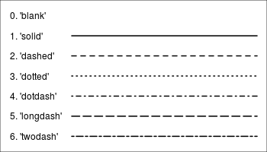
Create line plots and change line types
We can change the plot type with the argument type. It accepts the following strings and has the given effect.
“p” - points
“l” - lines
“b” - both points and lines
“c” - empty points joined by lines
“o” - overplotted points and lines
“s” and “S” - stair steps
“h” - histogram-like vertical lines
“n” - does not produce any points or lines
The argument lty is used to change the line type. A graph of the different line types is shown below:

Slide 8
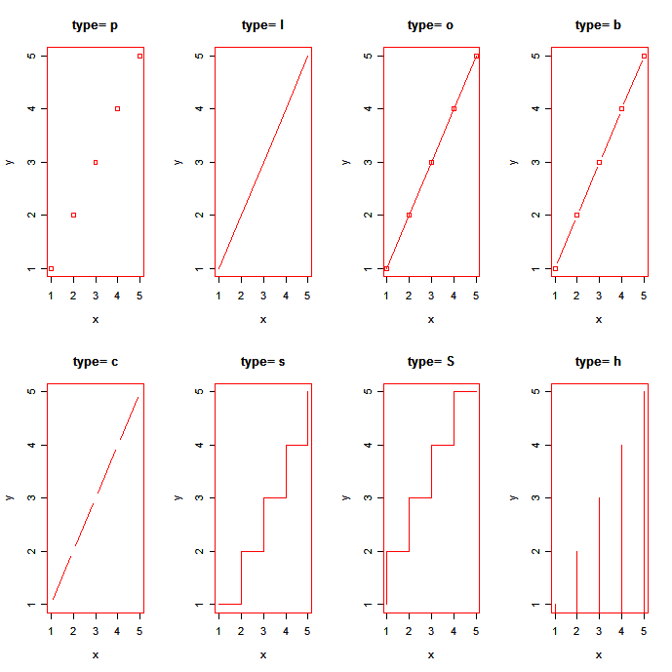

Slide 9
Create a plot with multiple lines
Simple format of line type function:
plot(x,y,type ='l',lty=1). Create the main plot frame.
lines(x,y,type ='l',lty=1). Add lines onto the plot.
Add a legend to a base R chart
To add a legend to a plot made in base R, the legend( ) function can be used.
The main arguments are:
legend : names to display
col : symbol colour
pch : symbol type
cex : text size
topright : legend position :bottomright, bottom, bottomleft, left, topleft, top, topright, right, center

Slide 10
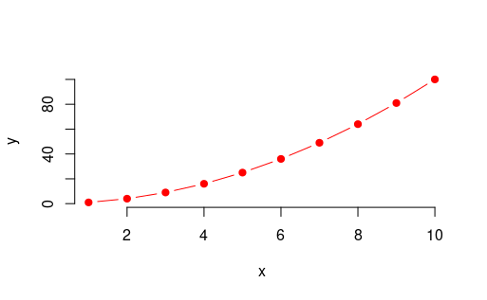
Lets see an example
We start by plotting a first single line with a solid line type. Next we add a second line with a dashed line style.Finally we add a legend on the plot using the R base function legend(),which take the same col and lty arguments as the line function. The option cex is used to set the legend text size.
Create some variables
x<-c(1:10)
y1<-x*x
y2<-2*y1
Plot a first line
plot(x,y1,type='b',pch=19,frame='FALSE',col='red',xlab='x',ylab='y',lty=1,lwd=1)

Slide 11
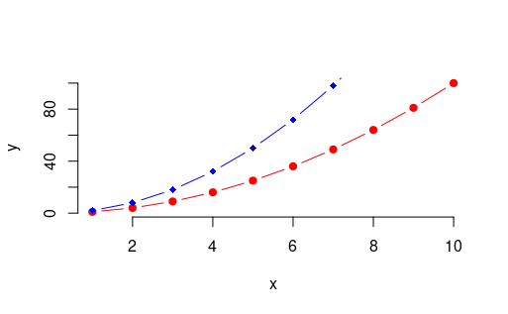
Add a second line
lines(x,y2,type='b',pch=18,col='blue',xlab='x',ylab='y',ity=2,lwd=1)
Add a legend to the plot
legend("topleft",legend=c('Lines1','Lines2'),col=c('red','blue'),lty=1:2,cex=0.8)

Slide 12
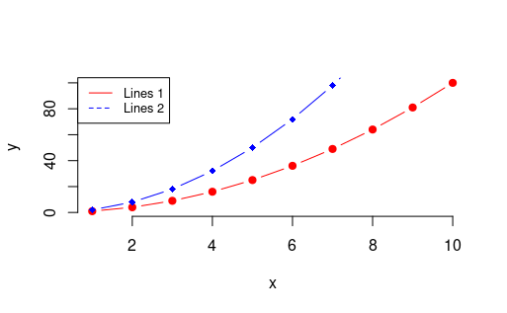
OUTPUT

Slide 13
USES OF LINE CHART
Line charts are used to track changes over short and long periods of time. When smaller changes exist, line charts are better to use than bar graphs.
Line charts can also be used to compare changes over the same period of time for more than one group.
Line charts can give a quick analysis of data.
You're able to quickly tell the range, minimum/maximum, as well as if there are any gaps or clusters.
Line graphs are useful in that they show data variables and trends very clearly and can help to make predictions about the results of data not yet recorded.
They can also be used to display several dependent variables against one independent variable.
When comparing data sets, line graphs are only useful if the axes follow the same scales.

Slide 14
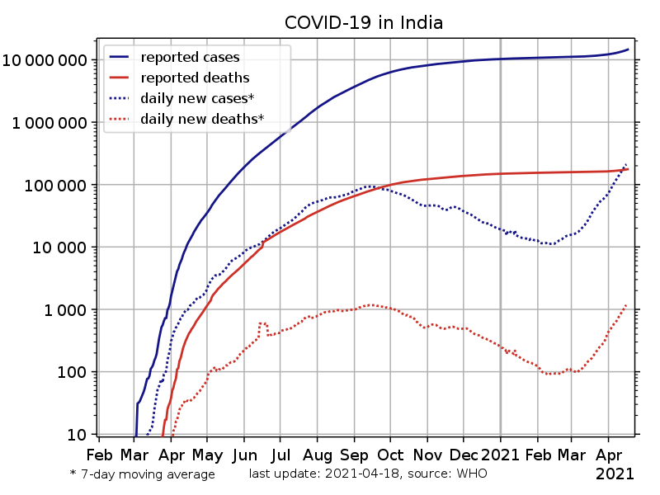
Real Life Use Of Line Chart
Line Chart can be very useful in Real life. One instance of this is the line chart representing the
Situation of Covid 19
Interpreting data from such line graphs helps us to know how well our own community is doing in fighting
the coronavirus pandemic

